Slide 1
Video 11 - Data analysis, Part 1
Steve Simon

Slide 2
Variable names
Brief, but descriptive explanation
Roughly 4 to 16 characters
No blanks and (Almost) no symbols
One to three words
Notes:
Define a brief variable name for every variable that you collect. It should be just long enough to be understandable, but short enough to minimize the typing in your data analysis program. I would recommend something between 4 to 16 characters and one or three short words.
Sometimes a very brief abbreviation is okay, like bw for birthweight or bmi for body mass index.

Slide 3
Good and bad variable names
Names to avoid (www.writersexchange.com)
systolic blood pressure
systolic-blood-pressure
Names that work
systolic_blood_pressure
systolic.blood.pressure
SystolicBloodPressure
Notes:
If your variable name is two or three short words (former smoker, or plasma beta carotene), you need to be careful. There’s a story about a group called Writer’s Exchange. They wanted to set up a website, www.writersexchange.com. It seemed like a good idea until they noticed that the website could be read as writer sex change. cannot use blanks between the words. It would work for some systems easily, for others, it would require some tedious work-arounds, and for still others, it would lead to system errors.
You can’t connect the words with dashes, because most systems will interpret the dash as a subtraction. Actually, just about any symbol (dollar sign, percent sign, asterisk) is a no-no. This can seriously stifle your creativity, but you have to live with it. Most statistical software programs reserve these symbols for special purposes, and if you use them in your variable names, you will confuse things.
There are two exceptions, the underscore character and the dot. These can be used almost anywhere. The dot is tricky in SQL and Java, as I understand it, but fine almost everywhere else. I believe the underscore is fine just about anywhere. But you can also use a mixture of upper and lower case, known as CamelCase.

Slide 4
Codes for categorical data
Beware of ambiguities
YES, Yes, and yes are three distinct levels.
Use number codes
0, 1, 9 for binary variables

Slide 5
Data dictionary
Also called a code book
Start before collecting data
Revise as needed
Notes:
The data dictionary, also known as the code book, is a short document (usually one page or less) that describes your data. It helps you organize and structure your data entry process. It also helps anyone else who might be working with you on the project. Finally, it is invaluable if you plan to share your data with outside groups.
You should start a data dictionary before you collect any data. You will find, during the data collection, that you failed to specify something important, and it’s okay to revise your data dictionary. Keep it handy when you need to figure out how to handle special cases, like the person who circled both 3 and 4 on a five point Likert scale.

Slide 6
Contents of a data dictionary
Variable names
Variable labels
Units of measurement
Permissible/impermissible values
Value labels
Missing value codes
Source
License
Notes:
The data dictionary should list variable names. We already talked about variable names. Also include a longer description, a variable label. The variable label can use blanks, special symbols, and typically has a longer length. Be sure to specify the units of measurement, if applicable.
If there are permissible/impermissible values or a legal range, then include this information in the data dictionary. It could be put in as part of the variable label or listed as a footnote.
If your variable is categorical, specify what the categories are. There is nothing worse than not knowing whether 1 is male and 2 is female or if 1 is female and 2 is male.

Slide 7
If you enter data into Excel
Do not use colors
Do not include summary statistics
Rectangular grid
Don’t squeeze two data values into one cell
Systolic/diastolic blood pressures
44M for a 44 year old male
Variable names in first row
No blank cells
Contradicts your book
Notes:
A lot of researchers do their data entry in Microsoft Excel or some similar spreadsheet program. This is, at best, sub-optimal. REDCap is a much better option. But if you decide to use a spreadsheet, be careful. Spreadsheets are very flexible. Too flexible. You can put some of your numbers over here and others over there and then some more in the middle, and what you end up with is a muddle.
The key rule for a spreadsheet is to use a rectangular grid. A rectangular grid has a single number at the intersection of every row and column. Don’t leave holes in your grid, even if the value is missing.
Don’t try to squeeze to pieces of data into the same cell. A common problem is when researchers put 120/80 into a cell to represent the systolic and diastolic blood pressures. When you enter data like this, you have two problems. First, there is no easy way to compute the average systolic or diastolic blood pressure. Second, some statistical software will see the slash and confuse it for division, converting your 120/80 into 1.5.
Use one cell for the systolic blood pressure and a different cell for the diastolic blood pressure. Likewise, an entry of 44M for a forty four year old male is troublesome. You can’t easily compute the average age or the percentage of males.
It’s a good idea to place the variable names in the first row of the spreadsheet. It’s not a strict requirement, as you have already provided the variable names in your data dictionary. If you are nice enough to do this, however, it will be easier to import the data. the first row also makes it possibile to spot check your data to make sure that the columns are lining up properly.
Don’t use the first two or three rows to organize your variables into headings and subheadings.
A lot of people will include some brief summary statistics as the last row or two of the spreadsheet. This is a bad idea, as the summary statistics might be confused for actual data points. If you need to compute a few summary statistics, learn how to place these in a separate worksheet.
Don’t use a lot of fancy formatting in your spreadsheet. This means, no colors, no different fonts or sizes, and no merged cells. All of this is lost when you import your data into SAS, SPSS, or R.
Let me emphasize one more thing. Do not use blank cells ever in your spreadsheet. If your data is missing, use a missing value code. This contradicts your book’s advice, but your book is wrong. A blank cell could easily be converted into a zero, if you’re not careful and zero is quite different than missing.
If the structure of your data is irregular and cannot fit into a rectangular grid, re-organize. If you have measurements on 24 treatment subjects and 26 controls, don’t put the outcome measure for the 24 treatment patients in one column and the 26 control patients in a second column. Put all 50 in a single column and add an additional column with 26 ones and 24 twos to distinguish who is a treatment patient and who is a control.

Slide 8
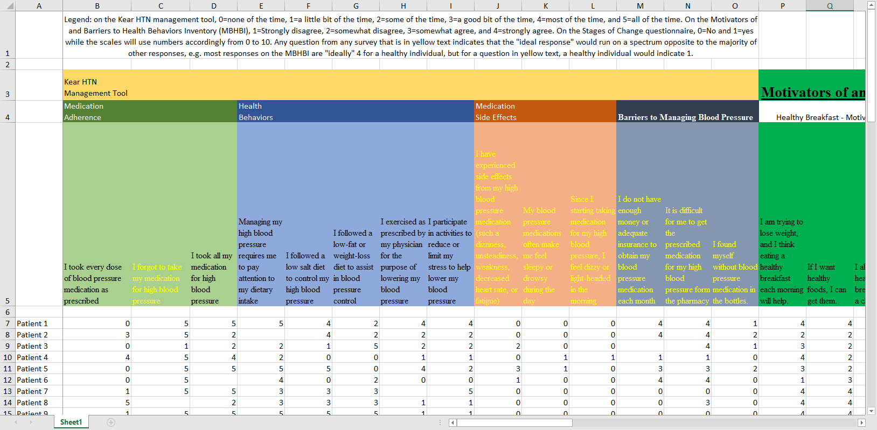
A poorly structured spreadsheet
A spreadsheet with data
Notes:
This image and the next three might be a bit tricky to see on your screen. You can download the original images from the Canvas site and magnify them, if you want to see the details.
Here is a spreadsheet that I received recently that violates many of the recommendations that I just made.
The first row contains information that should belong in the data dictionary. The second and third rows organize the variables into major groupings: the Kear HTN Management Tool, and the Motivators of and Barriers to Health-Smart Behaviors Inventory. There are subgroups within these two groups: Medication Adherence, Health Behaviors, Medication Side Effects, and Barriers to Managing Blood Pressure for the Kear HTN Management Tool, and Healthy Breakfast - Motivators, and some other subgrous for the Motivators of and Barriers to Health-Smart Behaviors Inventory.
The groupings and subgroupings belong in the data dictionary but not here.
The fourth column gives a description of each variable. The first two columns are: I forgot to take my medication for high blood pressure, I took all my medication for high blood pressure. These are much too long to serve as variable names. They would make great variable labels instead, and this information belongs in a data dictionary.
There is an important bit of information hidden in the formatting of the variable labels.
“Any question from any survey that is in yellow text indicates that the”ideal response" would run on a spectrum opposite to the majority of other responses, e.g. most responses on the MBHBI are “ideally” 4 for a healthy individual, but for a question in yellow text, a healthy individual would indicate 1."
So the ninth column (I participate in activities to reduce or limit my stress to help lower my blood pressure) is in black because a large value is good. But the tenth column (I have experienced side effects from my high blood pressure medication (such a dizziness, unsteadiness, weakness, decreased heart rate, or fatigue)) is in yellow because a small value is good.
The sixth row is totally blank which is great for readability but an annoyance when you import the data.
Finally, notice the blank cells. I found out that these represented cases where someone skipped a question.

Slide 9
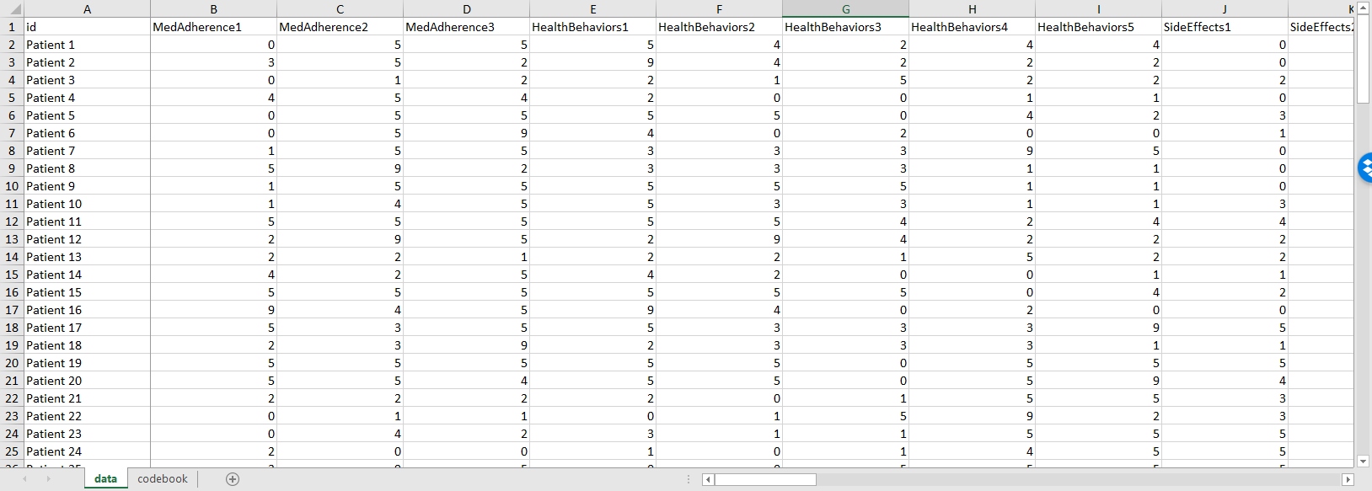
Revisions to this spreadsheet
A revised and better organized spreadsheet
Notes:
I was able to work with this data set, as is, without too much trouble, but here’s a modification that would have been a bit easier to work with.
The first row includes brief, but descriptive variable names. The column names are MedAdherence1 through 3, HealthBehaviors1 through 5, SideEffects1 through 3, and so forth. I anticipated that I would not need to distinguish among the particular questions within a subgroup, since I would probably just use an aggregate sum of each subgroup (after reverse scaling) for most of the analyses.

Slide 10
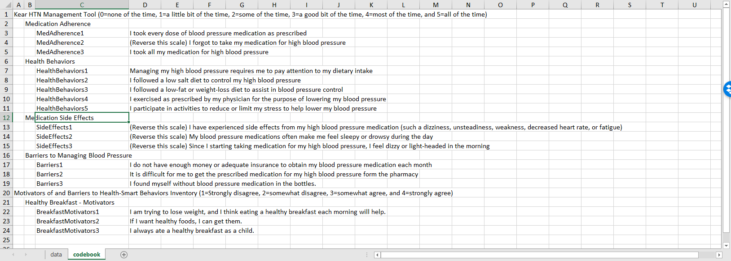
The codebook from this spreadsheet
A codebook associated with revised spreadsheet
Notes:
I also cut and pasted some of the preliminary rows in the original spreadsheet and restructured things a bit to develop a data dictionary.

Slide 11
Reverse coding
Context specific
Sequence of IF THEN ELSE statements
if (is.na(x)) then y=NA else if (x=1) then y=4 else if (x=2) then y=3 else if (x=3) then y=2 else if (x=4) then y=1 else y=9
Functional transformations
0,1 to 1,0 is f(x)=1-x
1,2,3,4 to 4,3,2,1 is f(x)=5-x
0,1,2,3,4 to 4,3,2,1,0 is f(x)=4-x
Always check your results
Watch out for missing value codes
Notes:
Reverse scaling is tedious and always go slowly, because tedium tends to produce simple mistakes. SPSS has a very nice recode dialog box that is hard to mess up. You can also use a series of IF THEN ELSE commands to do the reverse coding. Notice that I took the time to code as 9 anything outside what I believed were the only possible values.
But if you want to be clever, there is usually a simple mathematical function of the form k-x or k+1-x that will reverse scale everything all at once.
If you had a variable with values 0 and 1, the function f(x)=1-x will effectively convert the 0 to a 1 and the 1 to a 0.
If you had a variable with values 1, 2, 3, and 4, the function f(x)=5-x would effectively reverse these values. But note that if 0 were legal, if the possible values were 0, 1, 2, 3, and 4, then the proper function would be f(x)=4-x.
Always account properly for missing values when reverse scaling. It’s a good idea to do a simple frequency table before and after reverse coding. It is also a good idea to store the reverse coded variable under a different name, so that you could easily undo any mistakes that you might have made.

Slide 12
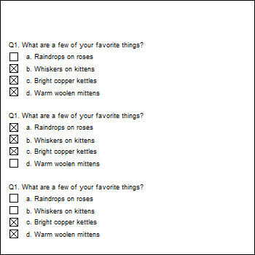
A multiple response example
Questionnaire with a multiple response question
Notes:
This is an example of a questionnaire where the patients can choose one of more of the following favorite things: Raindrops on roses, or whiskers on kittens. Bright copper kettles, or warm woolen mittens.
The first patient liked the last three things: whiskers on kittens, bright copper kettles, and warm woolen mittens.
The second patient liked first three things: raindrops on roses, whiskers on kittens, and bright copper kettles.
The third patient liked the last two things: bright copper kettles, and warm woolen mittens.
This approach makes it difficult to compute even simple statistics

Slide 13
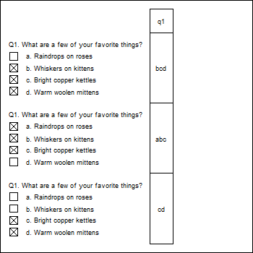
Coding multiple response with a single column
Multiple response coded into a single column
Notes:
You can code all the possible responses in a single column. Since the first person chose the last three responses, code their response as bcd. The second person chose the first three responses, and would be coded as abc. The third person only chose the last two responses, and would be coded cd.
This approach makes it difficult to compute even simple statistics, such as the proportion of patients who chose “Whiskers on kittens.” You’d have to work with a string search function. It’s not a terribly hard amount of work, but with a bit of planning, you could make it a bit easier down the road.

Slide 14
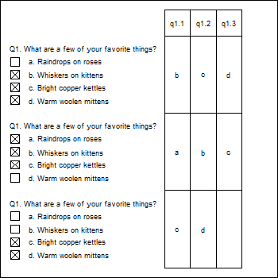
A different way to code multiple response
A multiple response question coded into three columns
Notes:
You could split this into three columns, putting the first selection in the first column, the second selection in the second column, and the third selection in the third column.
This is a bit better, but there are still some problems.
This format produces some unneeded missing values, such as for the patient who has less than three favorite things.
If you find out halfway through the survey that someone chose all four favorite things, you’d have to go back and add a new column.
This format is also a bit tricky. Notice how even though all three patients selected c, the letter appears once in the third column, once in the second column, and once in the first column. If you wanted the percentage of patients who chose “c,” you’d have to calculate the percentage of c’s in the first column, and add it to the percentage of c’s in the second column and the percentage of c’s in the third column.

Slide 15
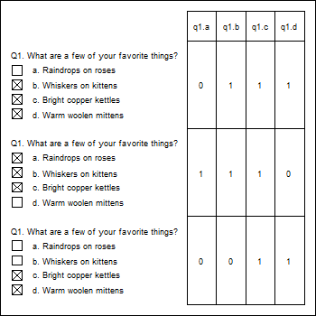
The recommended way to code multiple response
Multiple response coded with individual item indicators
Notes:
The recommended way to code multiple response is to create indicator variables for each possible response. The q1.a column is one for the second patient, as he/she was the only one who who liked raindrops on roses. The other two patients get a zero in this column. The q1.b column is one for the first and second patients, who both liked whiskers on kittens, but zero for the third patient who did not like whiskers on kittens. What’s wrong here? Who doesn’t like whiskers on kittens? The q1.c column is one for everybody because everybody liked bright copper kettles. Finally, in column q1.d, the first and third patients get ones for the like of warm woolen mittens, and the second patient gets a zero.

Slide 16
Text files
Fixed width
Delimited
Commas
Spaces
Tabs
“Quotes around text”
Notes:
You may wish to create a text file for others to use. The text format is popular for sharing your data, because others can inspect the data easily without needing any specialized software.
You can used a fixed width format. The

Slide 17
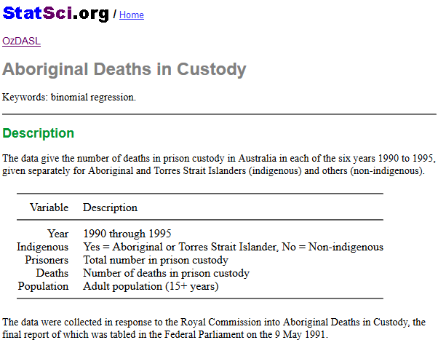
Data dictionary for aboriginal prison death study
Data dictionary
Notes:
Here is the data dictionary for a small data set that I will use to illustrate the various text formats. It comes from OzDASL, the Australian Data And Story Library. This data set represents the number of deaths in prison of both aboriginal Australians and others. The variables are
Yyear (1990 through 1995),
Indigenous (yes or no),
Prisoners, the number in prison custody,
Deaths, the number of deaths, and
Population, the adult population (15 years or older)

Slide 18
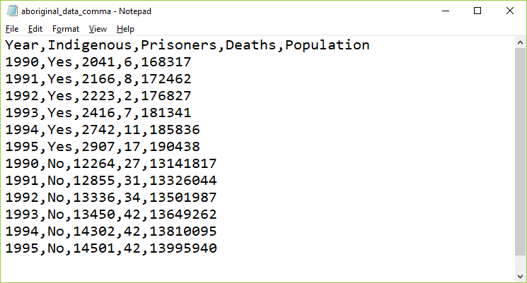
Comma separated values (csv)
Data set using a comma separated value format
Notes:
The most popular text format is the comma separated value. These files usually have a .csv extension. Each data point is separated from the other data values by a comma.

Slide 19
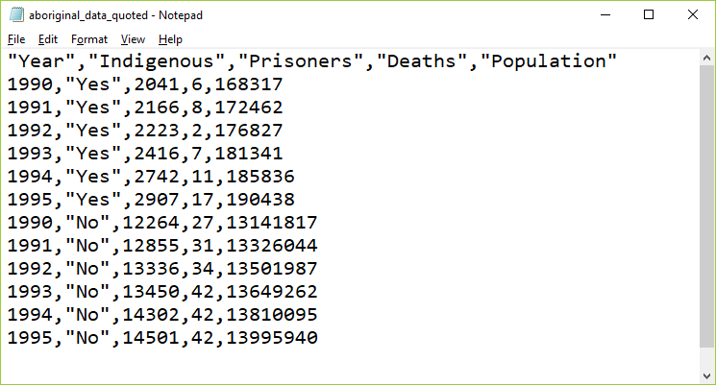
Comma separated values with quotes
Data set using a quoted format
Notes:
If your text data contains space, punctuation, or other special symbols, then it is a good idea to place quotes around your text. It’s not really needed for this data set, but I wanted to show you anyway.
There are elaborate rules for how to handle text data that contains quote marks. Use double quotes to surround text that includes single quotes and use single quotes to surround text that has double quotes. Doubling up a quote mark is another approach that usually works. It’s one of those tedious things that only Statisticians worry about.

Slide 20
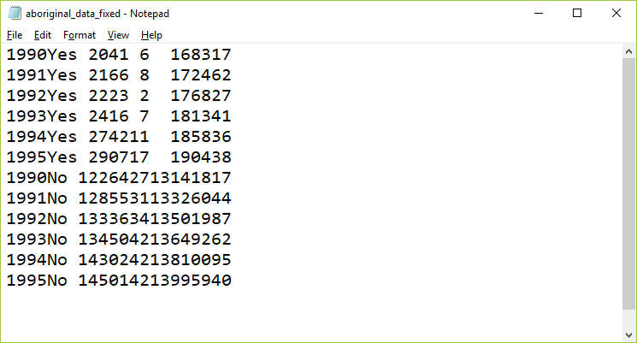
Fixed width format
Data set using a fixed width format
Notes:
In this fixed width format, the first variable, year, is listed in columns 1 through 4. Then the text variable, Indigenous, takes the next three columns, columns 5 through 7. The number of prisoners is either a four or five digit number, so it uses columns 8 through 12. The number of deaths is, thankfully small, either one or two digits, so it fits into columns 13 and 14. The population could be in the tens of millions, so it needs to use columns 15 through 22.
You need a fairly detailed data dictionary for fixed with format data, because otherwise you might not be sure where one number stops and another number begins.

Slide 21
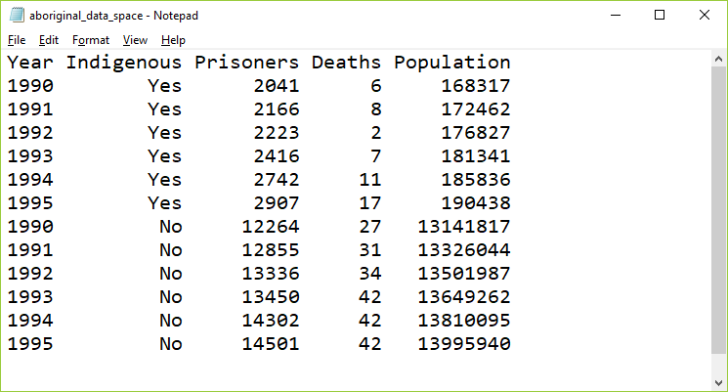
Spaced format
Data set using a spaced format
Notes:
Usually, you will encounter a fixed width format in data sets with hundreds of variables and thousands or millions of rows. In these files, saving a few characters here or there can make a big difference in download times. But for small data sets, you can insert a few extra blanks so that everything lines up nicely. Here is an example.

Slide 22
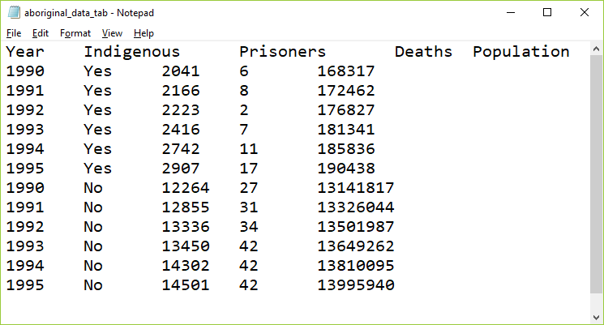
Tab separated values
Data set using a tab separated value format
Notes:
In the tab separated format, the tab character is used to separate values. The tab character effectively jumps to a specific fixed location. These locations are usually eight characters apart, starting at column 9, then 17, 25, etc.
The tab character appears to the human eye as multiple blanks but it is actually a non printing character, 09 in hexadecimal.
It’s hard sometimes to figure out if a file is using tabs or spaces as delimiters. Most text editors and word processors will let you search for the tab character, often with a code like /t (forward slash t). If you start to insert blanks in a tab delimited file, at first nothing happens, then all of a sudden, you notice a sudden jump in the text to the right of where you are inserting. Finally, look to see if the text seems to line up somewhat but with a few irregularities. This happens when some of the text data for a variable is longer than 8 characters and other text for that variable is shorter than 8 characters. In the example shown here, none of the data is longer than 8 characters, but the variable names are, which is why they don’t align perfectly with the data.

Slide 23
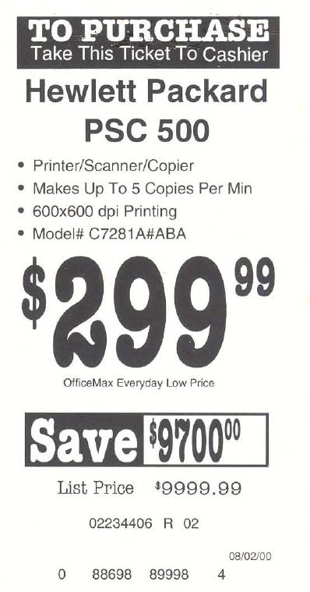
Missing value example
Price tage from computer store
Notes:
Here’s a humorous example of failure to account properly for missing values. The printer had a sales price of 299 dollars and 99 cents. The original price was listed as 9,999 dollars and 99 cents, which is an outrageous price for a printer. Clearly, a field of all nines was intended to be a missing value code. But the system that computed the savings did not recognize this as a missing value and calculated that if you bought this printer, you would be saving $9,700 dollars.

Slide 24
Missing value codes
Explain WHY the value is missing.
Did not answer
Not applicable
Below the limit of detection
Notes:
Sometimes you do not have data for a particular variable for some of your patients. This is perfectly fine. You must explain why the value is missing.
Sometimes a value is missing because a patient skipped the item on your questionnaire. Sometimes, it represents not applicable, such as your spouse’s age if you are not married. Sometimes, it represents a lab value below the limit of detection. There are a whole host of other reasons.
How you handle missing values in your data analysis depends largely on the reason why that value is missing. Using the wrong approach can seriously bias your results.

Slide 25
Example of missing value codes
Use extreme number code
9, 99, 999
-1
Use symbols
NA
(asterisk)
. (dot)
Never use blanks to designate missing
Note missing value code on data dictionary
Notes:
There are several ways you can code missing values. I recommend an extreme number code. 9 works well for values that can’t get any larger than 5. Use 99 or 999 if the values can get larger. You want to choose enough nines so that the value is clearly outside of any reasonable range of legitimate values. So a birthweight of 99 kilograms is obviously a missing value for anyone except for a baby elephant. An IQ score of 999 is outside the range even of Albert Einstein.
Some people use -1 for a missing value code if the variable is clearly not ever going to be a negative value. A baby could not have a birth weight of -1 kilogram, because such a baby would float up to the ceiling after being delivered.
If there are several reasons why a variable could be missing, use a separate code for each reason, such as 997 for lost test tube, 998 for insufficient volume for testing, and 999 for a result below the limit of detection.
You can also use symbols for missing values such as an asterisk or a dot. You can also use the letters NA, which is what R expects. These last three have a disadvantage for numeric variables. They end up confusing some imports and force your numeric column into a character string.

Slide 26
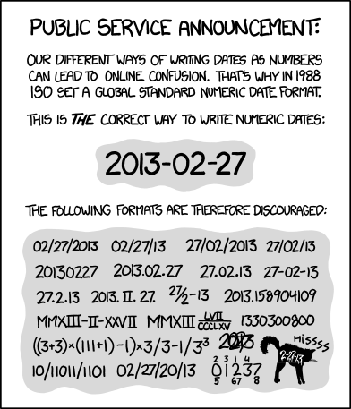
Date formats
Cartoon showing variety of data formats

Slide 27
Longitudinal data

Slide 28
Additional topics
As another aside, I was involved with a similar study (prospective, not retrospective). We planned this study using a one-sided hypothesis (remote prayer has a positive effect on health). The Institutional Review Board suggested changing this to a two-sided hypothesis (remote prayer has either a positive or a negative effect on health). Thankfully, we did not observe an outcome in the opposite tail as that would have been very difficult to explain.

Slide 29
Pilot testing
Clarity of items
Content
“Whether your items cover all aspects of the domain you intend to measure and whether they are in appropriate proportions relative to that domain.”
page 258

Slide 30
Data Collection Techniques
Process of developing a survey
List of measures/variables
What’s already available?
Put the pieces together
Test and revise as needed
Final check – do you really need all of the items?
Analysis of survey data
Notes:
Flows well and is clear.
Get some real test runs with people who have seen it for the first time. Do you really need all of these items?
[[Example of sexual preferences in survey on Internet usage.]]
http://www.pmean.com/10/BadSurvey.html

Slide 31
Coding
Mutually exclusive
Multiple response
“Other” responses
Use number codes for categorical data
Missing codes
Never use blanks for missing (book is wrong)
-1, 99
Multiple codes for multiple reasons
Dummy coding
0/1 for absence/presence
Reverse coding
High is always positive
Tabular format
No more than one piece of information
Double entry coding
Standard coding for race/ethnicity

Slide 32
Variable names
Not too short, not too long
Word delimiters
No spaces, symbols
Example for Mother’s age
Bad choices
mom age
mom-age
momage
Good choices
mom.age
mom_age
MomAge

Slide 33
Codebook
Also known as data dictionary

Slide 34
Quality checks
Minimum and maximum checks
Out of range
Zero variation
Missing value count
List five five rows, last five rows
Correlations

Slide 35
Data reduction
Create composite scores
Check Cronbach’s alpha
Examine leaving out single items
Factor analysis
Supplanted by Structural Equations Modeling

Slide 36
Data transformations
Ideal - selected a priori
Sometimes based on precedent
Sometimes motivated by theory
Sometimes based on empirical findings

Slide 37
Additional topics
Pilot studies
Questionnaires. http://www.pmean.com/02/questionnaire.html

Slide 38
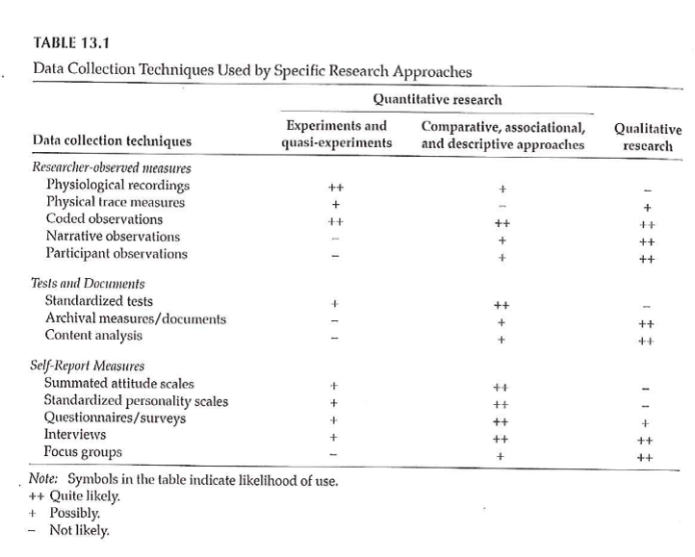
Data Collection Techniques
Notes:
Table 13.1 is useful in terms of the various things that we will touch on. It classifies by the two types of quantitative research and by qualitative research. Organized by the potential amount of patient filtering. The ones at the top should have less participant filtering. Also note that the symbols are not hard and fast rules, but represent the likelihood.

Slide 39
Data Collection Techniques
Standardized vs Investigator-Developed Instruments
Development and Use
Evidence to support investigator-developed instruments
Notes:
There is a lot of work in the development of standardized instruments, manual and documentaiton, normative values, apply to a broad area. Investigator developed instruments focus on a more specialized area, but you still need to supply information on validity and reliability.
Whenever possible use instruments already in use. You can find these in places like PROQOLID. This originally started as quality of life measurements, but has expanded. NIH compilation of patient reported outcome measures (PROMIS). NIH wants the research community to use common measures to allow easier compilation of studies in a meta-analysis.

Slide 40
Data Collection Techniques
Researcher-Observed Measures
Naturalness of the setting
Observer “participation”
Amount of detail
Breadth of coverage
Notes:
The focus is on direct observation. The more natural the setting, the less control you have. This might hurt the internal validity of the study. It is a trade-off.
How much does the observer participate. In interviews and focus groups, there is a very clear high level of participation. On the other extreme, observation in public places might not have any knowledge of their participation. In the middle are studies where participants know they are being observed, but this knowledge may fade into the background.

Slide 41
Data Collection Techniques
Tests and Documents
Standardized tests
Norm referenced test
Criterion referenced test
Achievement tests
Performance and Authentic assessments
Aptitude tests
Documents
Content analysis
Notes:
Norm scores allow you to compare to other scores (historical comparisons). These tests are very objective, but there is some subjectivity, perhaps, in their interpretation.
Measuring actual performance (ecologic validity). Tries to be very relevant to the setting.
Use existing documents. Existing records might have a higher level of accuracy but there is no gauarantee. Time is shorter because the documents already exist. Data extraction takes time. Do you need consent from the people associated with these documents.
Data abstraction is tedious, but the newer systems like i2b2 allow you to get the information more directly.
Content analysis is a more qualitative review. It gives you a lot of valuable information that a quantitative approach might miss.

Slide 42
Data Collection Techniques
Self-Report Measures
Standardized Personality Inventories
Attitudes / Beliefs scales
Likert scale
Semantic differential scale
Questionnaires
How delivered / administered
Item types
Interviews
Focus groups
Notes:
Personality inventories: the validity is dependent on an individual’s self-awareness.
Attitudes and beliefs done for a variety of purposes. A “representative sample of all possible opinions or attitudes about a particularl subject.” That’s why measurement experts cringe when you ask a single question. You need a multiple set of items to get at how people feel.
The Likert scale is very popular. You may not see the semantic difference scale, but examples will follow.
Delivery by mail or Internet. There are pros and cons to all formats. Item types could include open ended, partial (responses plus other), and close ended responses.

Slide 43
Descriptive Research
Surveys
Methods
Interview
Questionnaires
Design of surveys
Research question
Review of existing instruments
Process of designing survey
Notes:
Interview allows you to probe for comments. Video as well as audio is now available. It takes time and training. Concerns about anonymity with an interview.
Questionnaires are self-administered. Return rates are a concern. When sent out blindly, you can get low return rates, which hurts the generalizability of the study. There is potential for misunderstanding and people may get into a routine response and not provide as good quality of response.
Design the survey to address your research question. Thing about the pieces and the order.

Slide 44
Data Collection Techniques
Surveys
Survey question format –
Open ended
Close ended
Wording of questions
Scales
Scale of measurement
Response options
Notes:
Even as simple as something like age, you can ask it in an open ended format that allows you to categorize any way you like or even to forgo categorization.
Wording is important. Simplicity and reading level. Use standardized scales whenever you can.
Double-barreled questions. [[Ask option about supervisors and managers]]
How many times questions, think about the time frame (over the past 24 hours, past week, past month). Shorter time frames better recall, but subject to more external variations.
Building a level of trust. Don’t ask people to admit to “bad behavior”. Think of it from the perspective of the person providing the information.
[[Income: actual versus categories]]

Slide 45
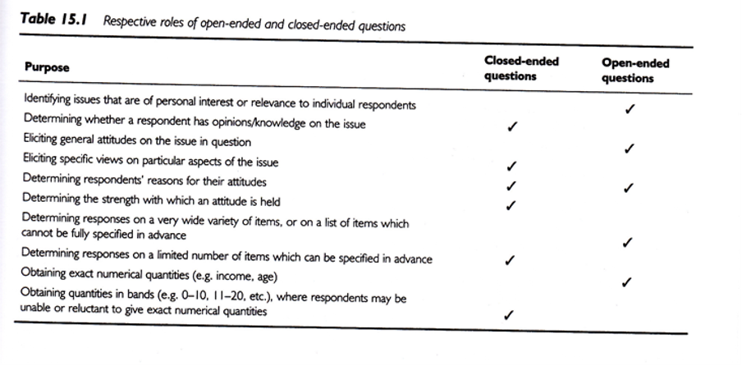
Data Collection Techniques
Notes:
Open ended vs Close ended
Respective roles of open or close ended format. This is a nice guide.
.footnote[Sim & Wright, 2002]

Slide 46
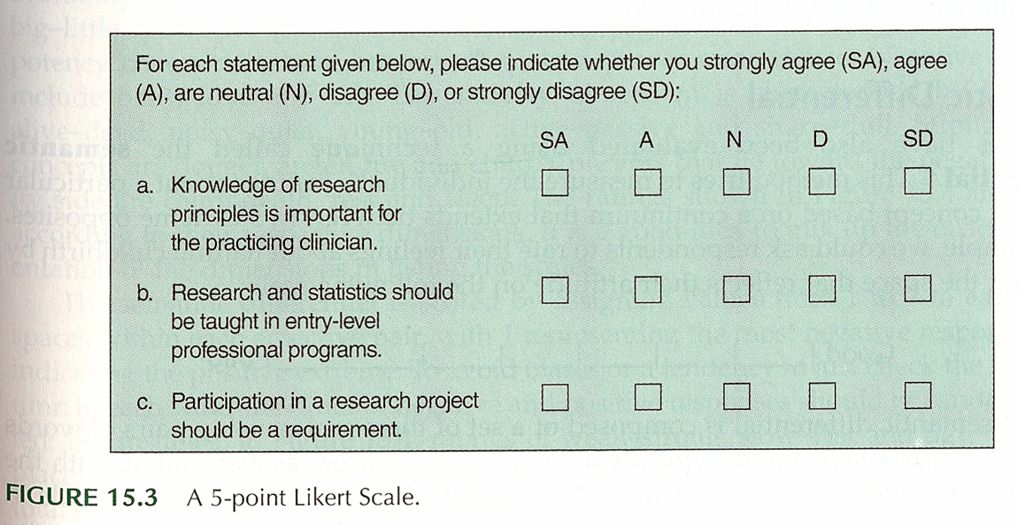
Data Collection Techniques
Notes:
Surveys – Response Options
Likert
.footnote[Portney & Watkins, 2009]
Example of five points (SD, D, N, A, SA)

Slide 47
Data Collection Techniques
..
Notes:
Everyone uses the term Likert with a hard-i, but the persons who developed this scale used a soft-i.
All items contributing to a total.
Some debate about the number of categories. Odd versus even. Even forces an opinion. Also a debate over a large versus a small number of items.
Do you want to reverse code some items. It could help keep the participants alert and thingking This may end up confusing. [[13 questions, but question 8, first question on the bakc page, was the only reverse coding.]]
Surveys – Response Options
Likert
.footnote[Sim & Wright, 2002]
Figure 15.8 is a different version of a five point scale.
Commercial plug for REDCap. Entry on a tablet. Coding is done on the back-end.

Slide 48
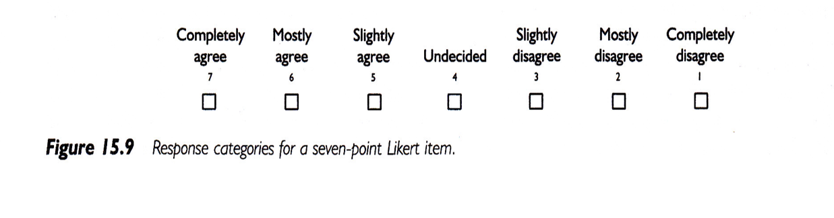
Data Collection Techniques
Notes:
Surveys – Response Options
Likert
.footnote[Sim & Wright, 2002]
Figure 15.9 shows a seven point response.
IRB insistence on a “Prefer Not to Answer” response. Contrast this to a “Neutral” option.

Slide 49
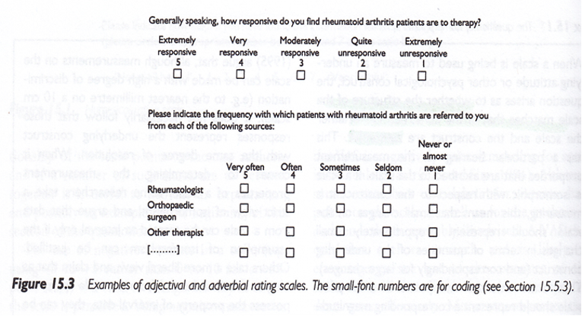
Data Collection Techniques
Notes:
Surveys – Response Options
.footnote[Sim & Wright, 2002]
Figure 15.3
These scales seem backwards to Mary. You don’t necessarily need to include the numbers are on the form. They can be added on the back end.

Slide 50
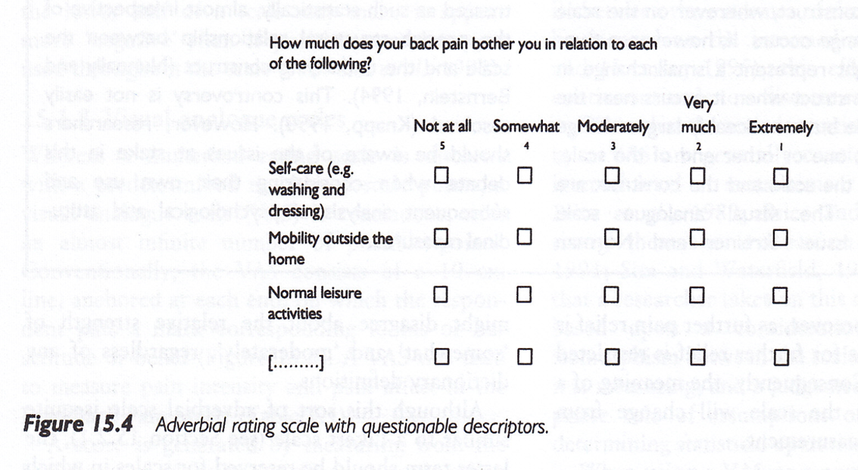
Data Collection Techniques
Notes:
Surveys – Response Options
Figure 15.4, Sim & Wright, 2002.
Not at all, somewhat, moderately, very much, extremely.
Note that the largest number is associated with “not at all”.
Double check that everyone agrees that somewhat is less than moderate, very much is less than extremely.

Slide 51
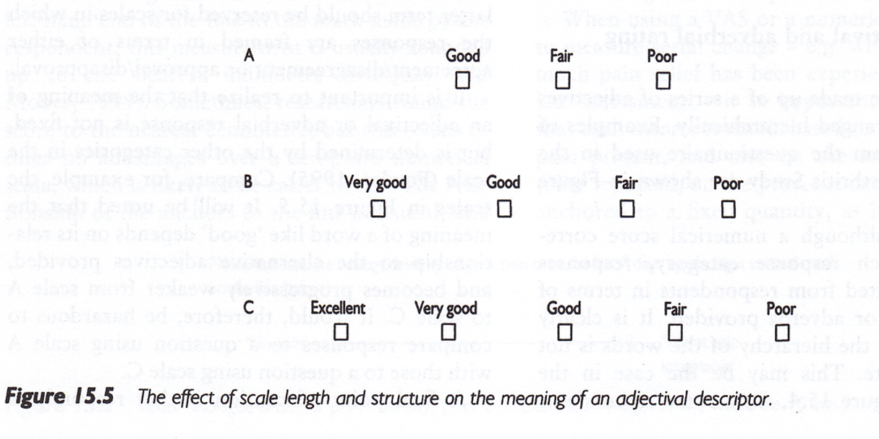
Data Collection Techniques
Notes:
Surveys – Response Options
Figure 15.5. [Sim & Wright, 2002]
Good, Fair, Poor is a three point scale. Add Very good for a four point scale. Add Excellent to get a five point scale.

Slide 52
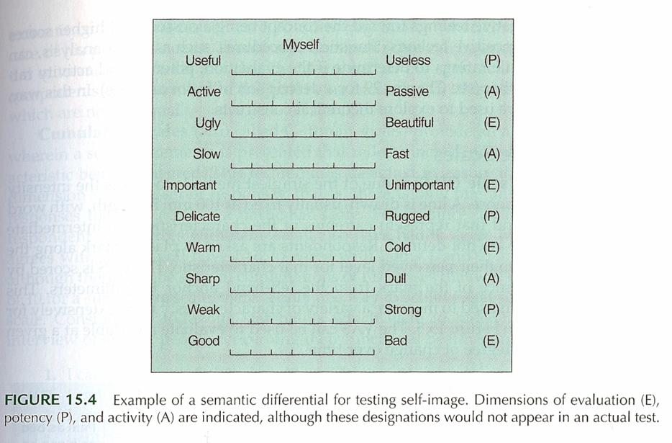
Data Collection Techniques
Notes:
Surveys – Response Options
Semantic Differential
Figure 15.4 [Portney & Watkins, 2009]
This is an example of a semantic differential. Seven point scale. Only label the extremes. Notice the reverse scaling of some items.

Slide 53
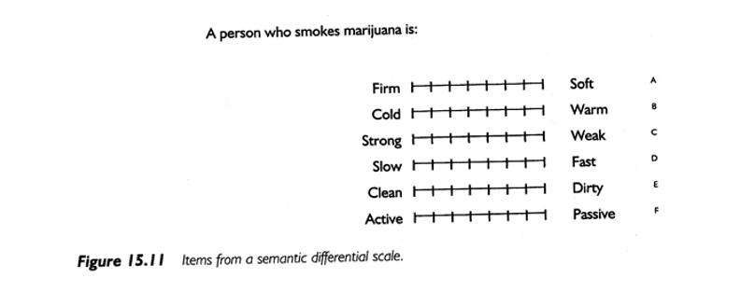
Data Collection Techniques
Notes:
Surveys – Response Options
Semantic Differential
Figure 15.11 [Portney & Watkins, 2009]
A second example of a semantic differential scale.

Slide 54
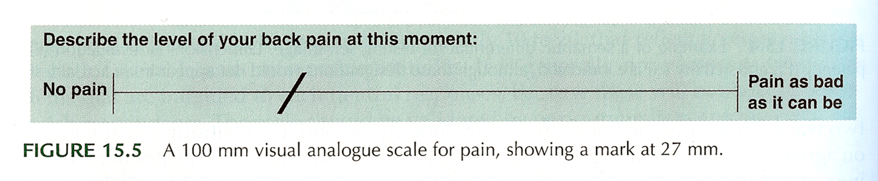
Data Collection Techniques
Notes:
Surveys – Response Options
Visual Analogue Scale (VAS)
Figure 15.5. [Portney & Watkins, 2009]
Commonly used for pain. Usually the line is 100 mm long. Gives you a number from 0 to 100, which allows you to treat this as a continuous variable.
Anchors at each extreme.
How do you handle a check mark.
This is a very labor intensive data entry task.
Note that the photocopy process can change the length of the scale (102 mm versus 100 mm).

Slide 55
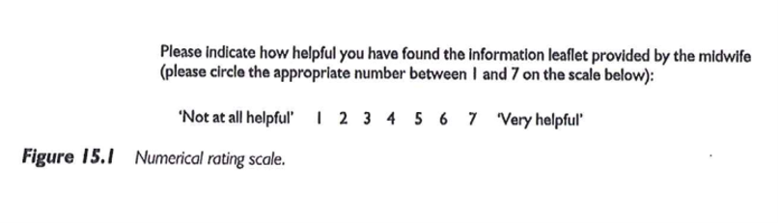
Data Collection Techniques
Notes:
Surveys – Response Options
Numerical Rating Scale
Figure 15.1 [Sim & Wright, 2002]
This scale has 7 numbers with anchors at each end.

Slide 56
Descriptive Research
Surveys
Pit-falls and words of caution
How responses are recorded
Wording of items
Literacy level
“ Loaded ” wording
Complexity of items
More than 1 “ unit ” in a single item
Clearly stated terms
Notes:
There are ways of checking the reading level of the survey. Good instructions. Branching (if “no” skip) patterns need to be laid out very clearly.

Slide 57
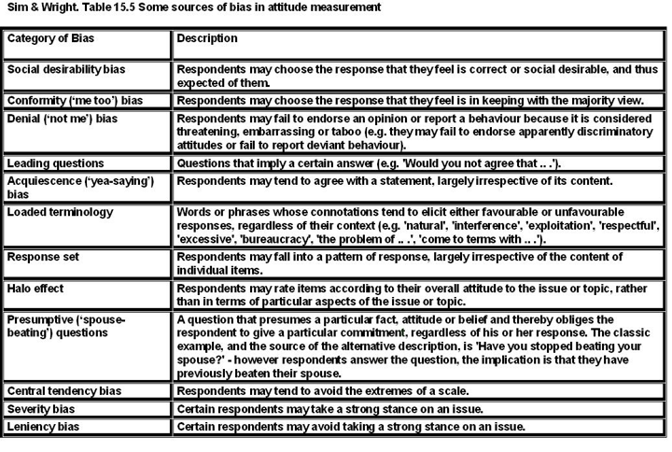
Data Collection Techniques
Notes:
Sim and Wright. Sources of bias in attitude measurement.
Social desirability, conformity, denial, acquiescence.
Leading questions, loaded terminology, presumptive (wife-beating)
Response set (stuck on the same value), or tendency to extremes.
Example of “push polling.”
“Any other comments?” http://www.biomedcentral.com/1471-2288/4/25.
http://www.pmean.com/04/DesigningQuestionnaire.html

Slide 58
Data Collection Techniques
Surveys – Example
Using a scale of 0 to 100, please indicate the percentage of time you take all the doses of your medicine?
… take all the pills in each of your doses?
… take all doses on the prescribed schedule?
… follow all special instructions …
… make sure you refill all of your medications on time?
Notes:
Medical history interview. Anti-retroviral medication, but some had no history yet, so used adherence in general. This gets tricky with multiple medications.
There’s an issue that came up when using this study, which will be discussed in the discussion board. Answer these questions yourself, and how you based your response to the second through fourth items.

Slide 59
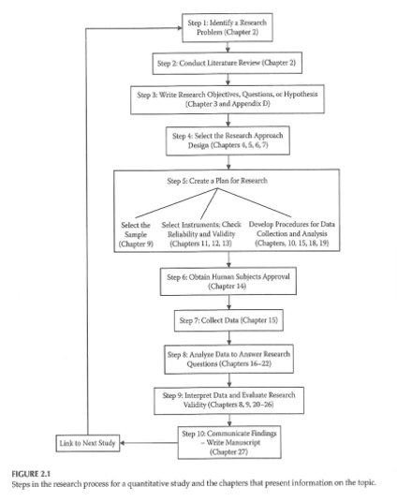
Data Collection & Coding
Notes:
Figure 2.1 from your book. This is back from Chapter 2, and keep this in mind when you are designing your data collection.

Slide 60
Data Collection & Coding
Initial Steps
Planning the study
Pilot testing
Data collection
Check for completeness if possible
Notes:
How things are working, where there is lack of clarity, how long does it take, where the systems don’t work.
Make sure that your extraction process is complete as possible for secondary data. For prospective surveys, flip through a survey upside down to see if items are all filled in. Hope that you haven’t missed a page. Electronic collection can force someone to respond before they answer the next question.
[[Ethically can’t force someone to complete a questionnaire.]]
How do you handle multiple responses.
Code the maximal detail of variables like age so you can collapse as you see fit. Make sure that you code missing or ambiguous responses consistently.
REDCap is great!
[[Double entry coding]]

Slide 61
Data Collection & Coding
Data Coding, Entry, and Checking
Guidelines
Mutually exclusive levels
Code for maximum information
Record is as complete as possible
Consistency
Data entry form
Checking entry

Slide 62
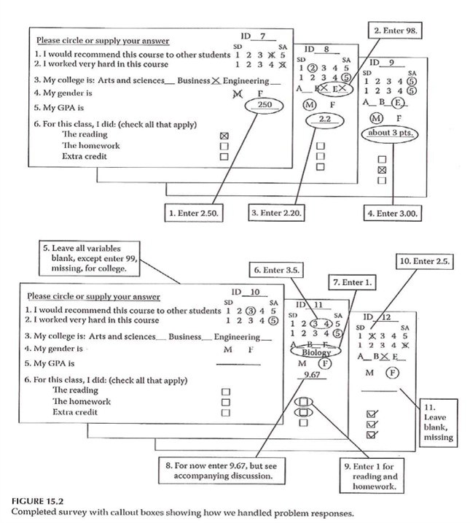
Data Collection & Coding
Notes:
Figure 15.2. Completed survey with callout boxes showing how we handled problem responses.

Slide 63
Data Collection & Coding
Data Entry into Statistical Program
Layout of data sheet
Variable names
Labeling
Variables
Values
Codebook / documentation
Notes:
[[See Intro to SAS/R material]]
By thinking about the backend process, you can sometimes fix things before you collect the data.
Mary uses Excel for documentation, but never for analysis, rarely for data entry.
Summarizes factor analysis, Cronbach’s alpha. Note whether better to have high score or better to have low score.
[[EUSpRIG site]]

Slide 64
Data Collection & Coding
Data Summation
Descriptive information
Categorical variables
Continuous variables
Data checking – part 2
Notes:
Look for inconsistent values, outliers, invalid values.
Note that certain responses on one question might lead to limits on the responses to other questions. Example, ever smoked? versus How many years?

Slide 65
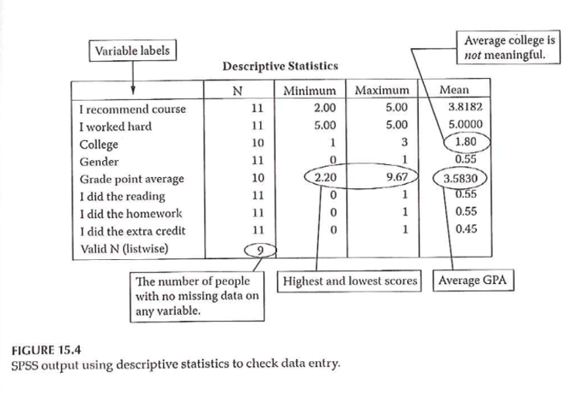
Data Collection & Coding
Notes:
Figure 15.4 shows SPSS output using descriptive statisticis to check data entry. Example of Likert scale where everyone responded 5. Note the number of responses/missing responses.
Hopefully, you’ve done such a good job planning that these issues don’t arise after the data is collected. [[Ha!]]

Slide 66
Measurement dichotomies
Standardized versus investigator developed measures
Researcher evaluation versus patient report
Field measurements versus laboratory measurements
Ecological validity
Standardized test

Slide 67
Researcher evaluations
Norm referenced tests
Criterion referenced tests
Achievement tests
Performance assessment
Authentic assessment
Aptitude tests
Projective technique
Documents

Slide 68
Self report
Standardized personality inventories
Paper and pencil
Machine scored

Slide 69
Questionnaires
Definitions
Survey
Questionnaire
Interview

Slide 70
Delivery
Remote administration
Mail
Internet (Survey Monkey)
Direct administration

Slide 71
Structure
Open ended
Partially open ended
Unordered closed response
Ordered closed response
Interviews
Telephone
Face-to-face
Focus groups

Slide 72
Analysis of Qualitative Data
http://blog.pmean.com/semi-structured-interviews/
Positivism versus constructivism, revisited
https://www.sagepub.com/sites/default/files/upm-binaries/29985_Chapter1.pdf
http://blog.pmean.com/recommended-philosophy-news-network-postmodernism-special-report/
Tools: semi-structured interviews, participant observation, photo elicitation(?), mapping exercises(?), web and space design workshops(?), archival records, physical artifacts,
Typically, a one-hour interview requires a minimum of three to four hours (or more) of analysis.
Involve the participants in the process, especially for narrative research.

Slide 73
Analysis of Qualitative Data
Inductive process –
Start with the specific (raw data / transcript)
Develop a theoretical framework from the data
Conceptual categories emerge from the data

Slide 74
Analysis of Qualitative Data
Start the study with a research question
This may provide a potential starting point for analyzing text
If you do this, DO NOT let it prevent you from seeing what is in the text
Steps
From raw data to theory building
“ Iterative ” process
e.g. , as you are developing categories, check them back against the raw data – do they continue to reflect the original data?
Notes:
Keep alert and look for things that come out in the material that you were not anticipating. As your categories, go back and compare them against the raw data. Make sure that you allow the data to guide you. Often coding from transcripts. But it is also good to have access to the original recordings. Sometimes there is a doubt about what some was saying (joking or sarcasm). Look for tone of voice and non-verbal cues.
Content analysis is a generic term, but you can look at things like ad messages in magazines that appeal to young adults.
Thematic analysis is looking for patterns.

Slide 75
Analysis of Qualitative Data
Analysis process –
Given research question, may have some idea of a general conceptual structure; serve only as a starting point
Usually work from transcripts
If possible, refer back to audio recordings when needed
Qualitative form of analysis
Content analysis – analysis of the content of communication
Thematic analysis – identifying patterns or themes in the data
Notes:
Break up the text into “bits” that represent specific thoughts. Open coding lots of themes. Axial coding looks at the relationships between themes, builds a superstructure of ideas.

Slide 76
Analysis of Qualitative Data
Category Formation – assign sections (data bits) to analytical categories/themes “coding”
Summarizing the data by identifying similarities and differences / commonalities and contrasts
Categories:
More manageable units of information
“open coding”
Descriptive – Concrete
Interpretive – Abstract
Relational
Cross-reference categories back to text
Makes it easier to revise coding as needed
Notes:
Software allows you to go back and forth between themes and the original text. Cross-referencing is important. Find examples easily. It helps provide validity checks. Does someone agree with your categorization.
Categories need to be faithful to the data. This is internal validity. But you need to place this in a broader understanding.
You need to be careful about trying to quantify this too much. Keep in mind that just because someone talks about something a lot does not mean that this is the most important thing to them. The most important thing might be something that people are uncomfortable talking about.

Slide 77
Analysis of Qualitative Data
Category Formation
Faithful to the data – “internal” aspect
Meaningful to other categories – “external” aspect
Balance
Generality vs Specificity
Inclusivity vs Exclusivity
Number of times idea mentioned does NOT necessarily reflect importance

Slide 78
Analysis of Qualitative Data
Labeling / Revising Categories
Member-generated – “ first-order ” account
Observer-generated – “ second-order ” account
Labels are provisional; may be revised
Iteration – move back and forth between raw data and labeled categories
“ Zoom in ” vs “ Wide angle ” view of the coding
Revision – may end up dividing or combining categories
May establish criteria for category coding
Notes:
Phrasing of the person versus observations generated by the researcher. Labels should be considered as provisional as you work with more complete information. It is an iterative process. Go back to original data. You’re looking at the specific of what’s been told versus a broader understanding.
Establishing the criteria may depend on how many people are doing the coding. If you don’t have a pre-existing structure, the coding may evolve and may involve 100% review (both raters review everything and resolve discrepancy). Then a third person does an audit.

Slide 79
Analysis of Qualitative Data
Saturation – the point at which you are not gaining any new insight, no new categories being identified, no new relationships being defined
Don’t need any additional analysis
Don’t need any additional data collection (if collection & analysis done in parallel)
Determinant – nature of the information being collection – NOT amount of information
Keeping notes – of the coding/analysis process
Help identify categories/relationships
Help if “stuck”
Document analysis process
Notes:
Saturation is a way to assess your sample size. Have you gotten a representative amount of data.
Really important to keep notes of the coding and analysis process, so you can check your work. Allows you to do qualirty checks on the process.

Slide 80
Analysis of Qualitative Data
Role of Judgment
Balancing act –
Level of creativity by coder to identify categories/relationships
Must reflect the informants thoughts
Audit of the coding by an independent person can check for the match between the coding and the source information
Low-inference descriptors
Look for “negative cases”
Notes:
You develop a framework, but that framework must always represent what the subjects have said.
Low inference descriptors are those things involving just the basic words or text.

Slide 81
Analysis of Qualitative Data
Quantifying Information
Pros & Cons
When quantifying might be of value
Simple frequency of occurrence does NOT necessarily reflect importance
Notes:
This was mentioned earlier.

Slide 82
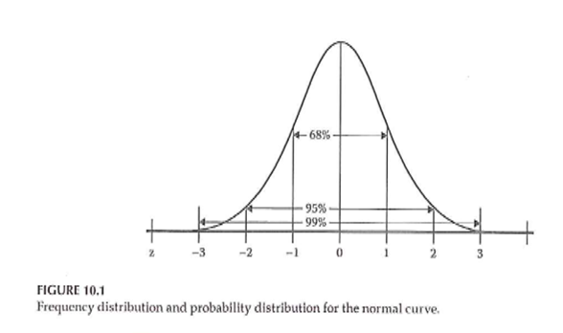
Descriptive Statistics
Notes:
Figure 10.1 shows the standard bell shaped curve.

Slide 83
Descriptive Statistics
Descriptive graphs
How to look at your data
Options for viewing your data
Frequency polygons
Histograms
Bar charts
Notes:
Even for a qualitative study, you’ll still want to describe characteristics of your sample.
For a fancier inferential analysis, you still should start with a descriptive analysis.

Slide 84
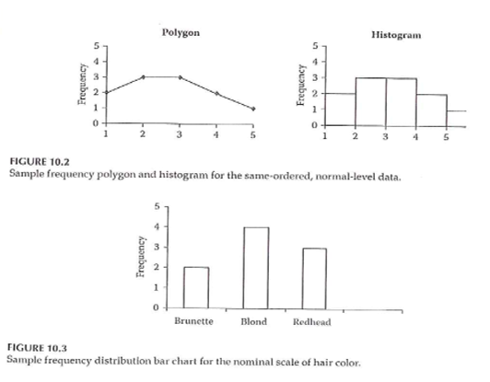
Descriptive Statistics
Notes:
Figures 10.2 and 10.3.
Frequency polygon has a line connecting values and implicitly represents a normal distribution.

Slide 85
Descriptive Statistics
Measures of central tendency
Mean
Median
Mode
Notes:
These terms should already be familiar to you. The mean is the best choice for approximately normal distribution. The median is better for non-normal continuous variables and ordinal variables.

Slide 86
Descriptive Statistics
Measures of variability
Range
Standard deviation
Interquartile range
How many categories
Notes:
The standard deviation is considered a poor measure of variability for a non-normal population. The interquartile is the difference between the 75th percentile and the 25th percentile. Define the 25th percentile as the value so that approximately 25% of the values are smaller and 75% are larger.

Slide 87
Descriptive Statistics
Measures of association between 2 variables
Correlation
Pearson
Spearman
Cross-tabulation
Scatterplot
Notes:
A correlation is a value between -1 and +1. There are two versions. Use Spearman for non-normal or ordinal variables.
Cross-tabulation is best for nominal and ordinal variables.

Slide 88
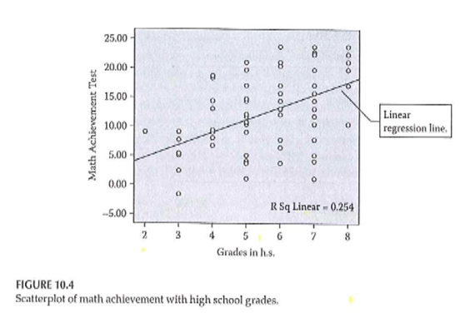
Descriptive Statistics
Notes:
Figure 10.4 shows the relationship between grade level and performance on a math achievement test. It shows a trend line and an R-squared value.
Note that this is an association but not necessarily a causal relationship. Knowledge of one variable helps you predict the other.

Slide 89
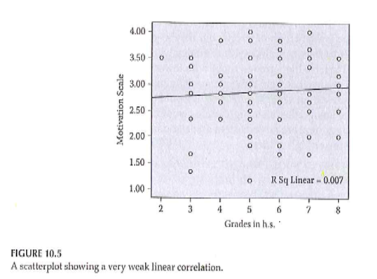
Descriptive Statistics
Notes:
Figure 10.5 shows a much weaker relationship between grade level and motivation scale. The trend line is flat and the R-squared value is small.

Slide 90
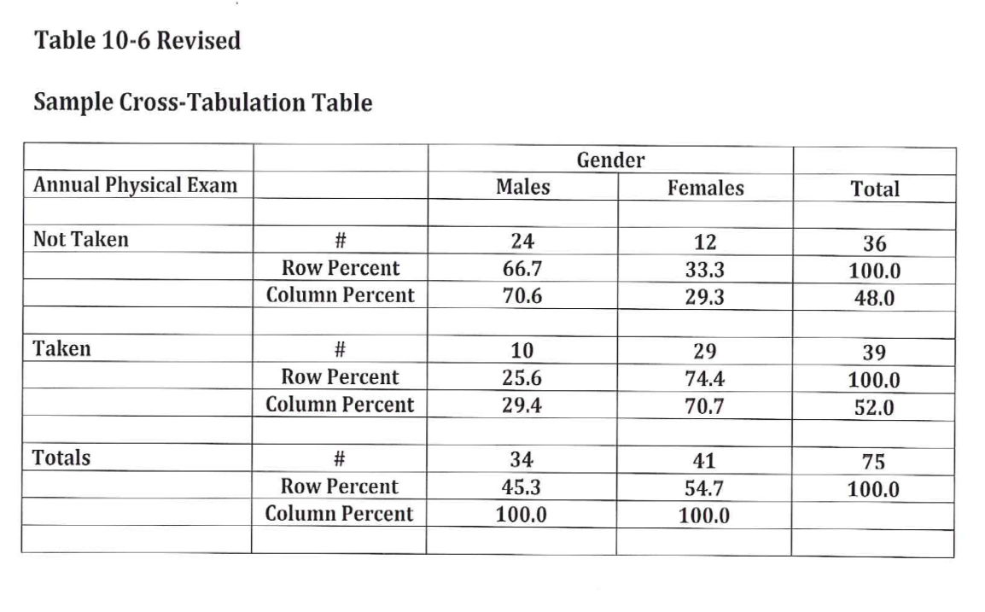
Descriptive Statistics
Notes:
Table 10.6 shows a cross-tabulation. Mary revised this to include row and column percentages. Orient towards the row totals or the column totals. Row percentages add up to 100% within each row and column percentages add up to 100% within each row.
You might compute both row and column percentages, but only include one in your final table.

Slide 91
Descriptive Statistics
Properties of the normal curve
Unimodal
Mean, median, and mode are equal
Symmetric curve (skew)
Range is infinite
Shape – not too peaked or flat (kurtosis)
Notes:
This is not a Statistics class, but is intended to help you decide how to choose analyses for your research plan.
There are five properties. Unimodal, symmetric (no skewness), infinite range, peakedness or flatness tells you information about the tendency to produce outliers.
[[Talk about range restrictions.]]

Slide 92

Descriptive Statistics
Notes:
Figure 10.1 (normal curve) again.

Slide 93
Descriptive Statistics
Standard normal curve
Definition
How to compute
Effect size
Notes:
Set the mean to zero and a standard deviation of one. The standard normal curve is useful for effect size calculations and power analysis.

Slide 94
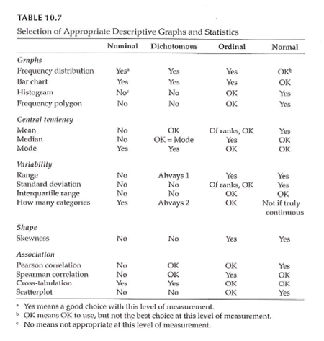
Measurement & Descriptive Statistics
Notes:
Table 10.7. This is a great table that tells you what graphical and numeric summaries are appropriate for what types of data. This doesn’t address the statistical tests (inferential analyses).

Slide 95
Making Inferences - NHST
Populations versus Samples
Use inferential statistics
Sample statistics (M, SD) <U+F0E8>
Population parameters (mu, sigma)
Null Hypothesis Significance Testing (NHST)
Null hypothesis (H 0 )
Alternative hypothesis (H 1 )
AKA research hypothesis
Directional
Non-directional
Notes:
We are talking about data analysis and interpretation. Planning. Some of this will be familiar to you. This is not a full statistical coverage of the topic.
Take the data from the sample and make inferences about the population. The sample is a subset. Inferential statistics is the process by which you infer information about the population.
NHST is the traditional way that a huge amount of research relies on.
Null hypothesis is no difference or no relationship. The alternative is often called the research hypothesis.

Slide 96
Making Inferences - NHST
NHST – Goal of research –
Reject the H 0 in favor of H 1
“Reject” the null hypothesis
Practically – “reject” means difference / relationship greater than just random variability
Alternative hypothesis –
3 versions
Non-directional
Directional positive
Directional negative
Notes:
Does the data allow us to reject the null hypothesis. Rejecting means the difference or relationship is greater than what you’d expect due to sampling error.
[[Directional only for two group comparisons or bivariate relationships]]
never talk about proving the null hypothesis. A large p-value does not mean that you proved the null hypothesis. There might be sources of error that lead to failure to reject the null hypothesis.

Slide 97
Making Inferences - NHST
Directional vs Non-directional H 1
Comparing treatment to control
Comparing different treatments
Choosing directional vs non-directional
Basis for choice
Consequences
Statistical analysis
Interpretation
Notes:
Directional is more likely when comparing a treatment to a control [[placebo]]. When comparing two different treatments, you would have to use a non-directional hypothesis.
Is there existing evidence to support a directional hypothesis.
If you use a directional hypothesis, and you get an extreme result in the opposite direction, you can’t claim statistical significance.
Some people think that directional hypotheses are “cheating”.

Slide 98
Making Inferences - NHST
Sampling review
Target / theoretical population
Accessible population
Sample
Inference from the study sample to the population
Notes:
So how well does your sample reflect the population?

Slide 99
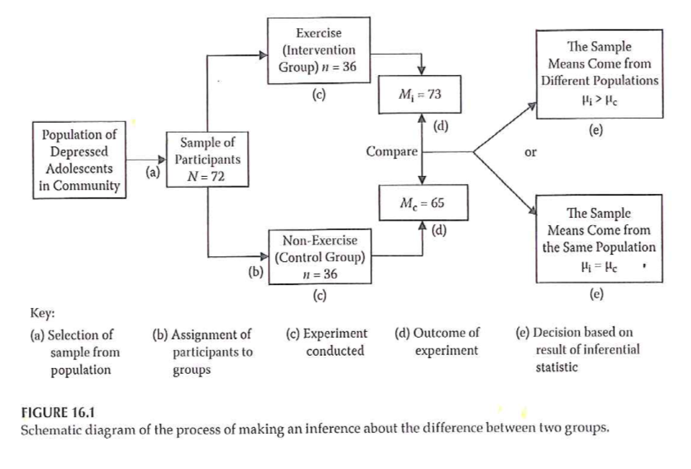
Making Inferences - NHST
Notes:
Example
Figure 16.1 from your book.
Flow chart of selecting from a population, randomizing to two groups, and then comparing the results in each group, and choosing between two hypotheses.

Slide 100
Making Inferences - NHST
Accessible population -> Sample
Random assignment to groups
Conduct study and collect data
Conduct statistical analysis
Intervention group: mean = 73
Control group: mean = 65
Notes:
[[This is a re-iteration of Figure 16.1]]
From your basic Statistics class, you may recognize that this setting would require a two-sample t-test.
[[Knowing which statistic to use in what setting is one of the most difficult tasks that you will encounter.]]

Slide 101
Making Inferences - NHST
Significant difference or not?
Inferential statistics – allow you to determine this
Reject the null ->
The observed difference is highly unlikely if the null hypothesis is actually true
Fail to reject the null ->
We can not say that the observed difference is highly unlikely
Do NOT “accept” the null hypothesis
Notes:
[[If a particular sample result is unlikely under the null hypothesis, this causes you to question the null hypothesis.]]
Reasons why you failed to reject the null hypothesis. A poorly implemented intervention, failure to use valid and reliabile measures, quality problems during the study.
Why never say that we accept the null.

Slide 102
Making Inferences - NHST
( Portney & Watkins, 2009)
Notes:
This is a table of possible outcomes H0 true, H0 false versus reject H0, accept H0.
Define power as the probability of rejecting the null hypotheis when the alternative hypothesis is true. [[Since the ]]

Slide 103
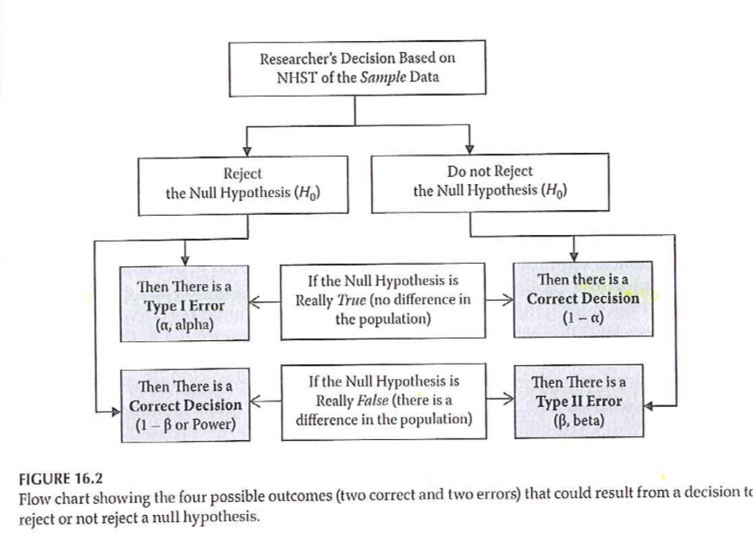
Making Inferences - NHST
Notes:
Statistical testing – possible outcomes
Figure 16.2 provides a different way of displaying Type I and Type II errors in a two by two table.

Slide 104
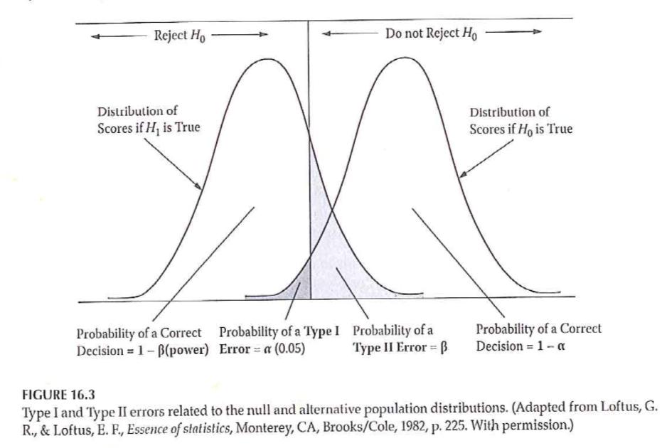
Making Inferences - NHST
Notes:
Statistical testing – possible outcomes
Two normal distributions and bell shaped curves.
Figure 16.3 from your book. Directional negative hypothesis. Example an intervention that results in a reduction in symptoms/pain.

Slide 105
Making Inferences - NHST
Statistical testing
Fig 16.3 – Directional negative
Example – hypothesize that intervention will result in reduction of symptoms
If you made a directional positive alternative hypothesis …. ?
Notes:
[[This is a rehash of Figure 16.3.]]

Slide 106
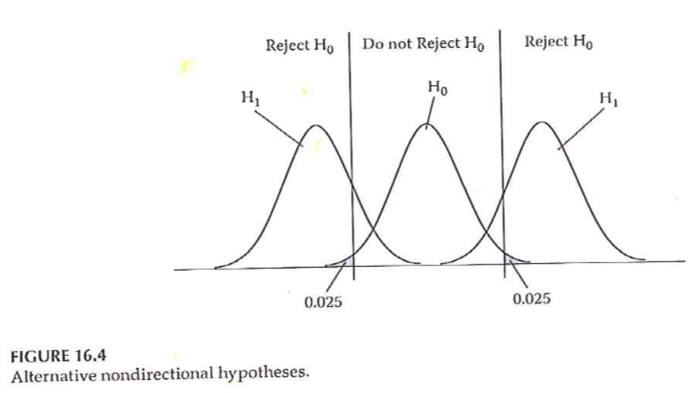
Making Inferences - NHST
Notes:
Statistical testing
Fig 16.4 – Non-directional

Slide 107
Null value

Slide 108
Critical value

Slide 109
Alpha level

Slide 110
Power Analysis
Probability of rejecting a false H 0
This is a GOOD thing!
Want to maximize this (within reasonable limits!)
What is power analysis
“… the probability that his investigation would lead to statistically significant results.”

Slide 111
Power Analysis
( Portney & Watkins, 2009)

Slide 112
Type I and II errors
~, ~TRUTH, ~, “DECISION”,“H o is true (there is no relationship)”,“H o is false (there is a relationship)”, “Reject H o (you find a relationship)”,“Type I Error Alpha”,“Correct (Decision agrees with Truth ) Power”, “Do not reject H o (you do NOT find a relationship)”,“Correct (Decision agrees with Truth)”,“Type II Error Beta (Power = 1 - Beta)”

Slide 113
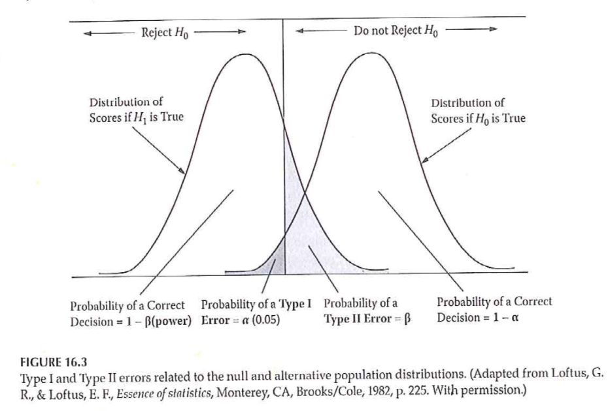
Power Analysis
Notes:
Power of a study – probability of rejecting a false null hypothesis

Slide 114
Power Analysis
Statistical power analysis concepts (Cohen)
Significance criterion – alpha
Power – desired level
Sample size
Effect size
Power analysis method depends on research design

Slide 115
Power Analysis
Performing a power analysis when planning a study
What is the study design?
What do you already know about the measure you are interested in?
What significance level to you want to use for hypothesis testing?
What level of power do you want to achieve?

Slide 116
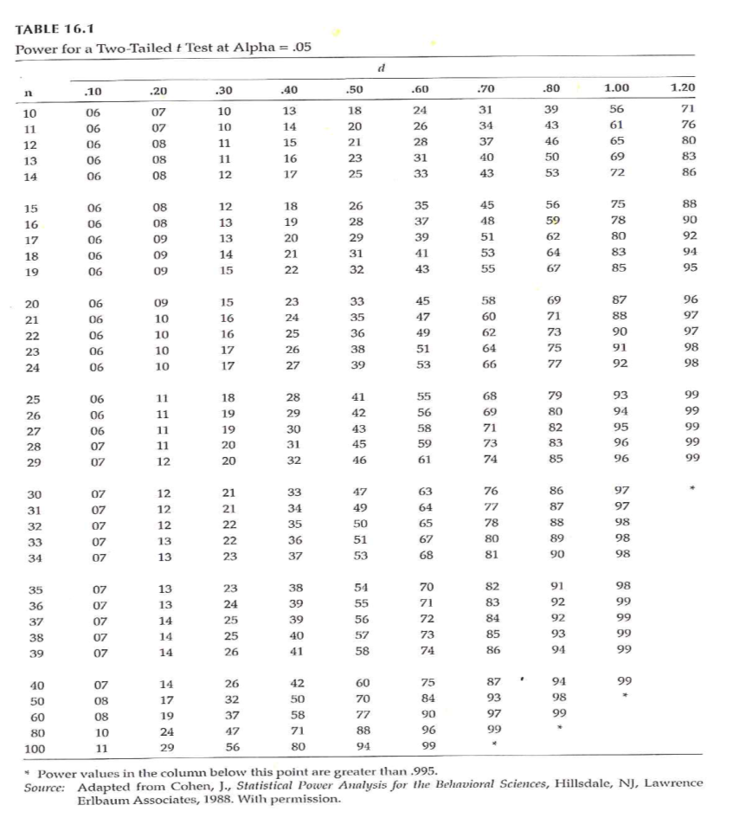
Power Analysis
Notes:
Determining power (Fig 16.1)

Slide 117
Power Analysis
Increasing power –
Alpha level
Formulation of hypothesis
Decrease variability / increase precision
Groups
Outcome measure(s)
Increase sample size

Slide 118
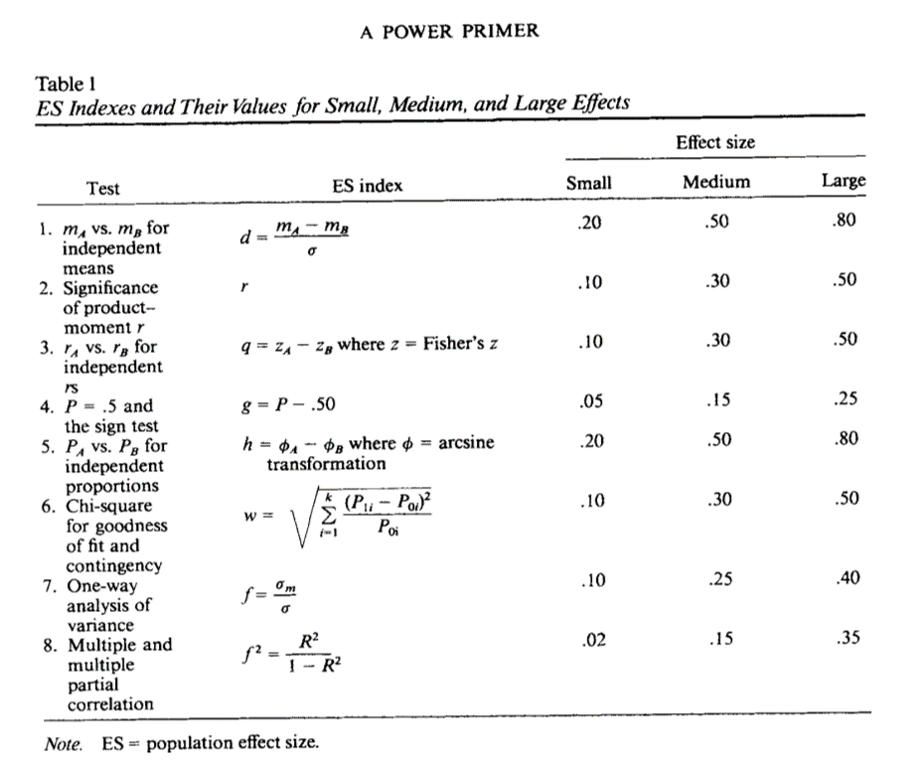
Power Analysis

Slide 119
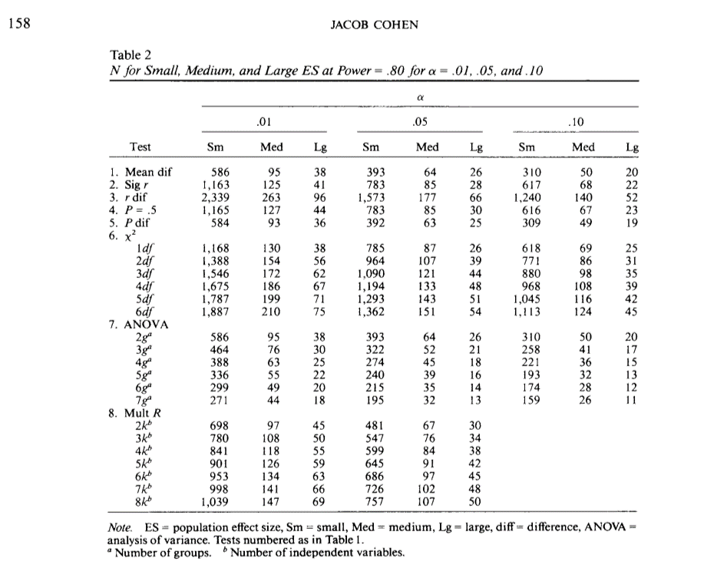
Power Analysis

Slide 120
Problems with NHST
Knowledge based on outcome of single study
Interpretation of statistical significance
Complications
H 0 is rarely true – in a strict sense
Too large of a sample size – hard NOT to get statistical significance
Significance testing as a dichotomous decision
Interpretation of changes in the p value
Statistical significant versus clinical/ substative meaningfulness
Notes:
There is always a level of uncertainty associated with a single study.
[[ASA statement on p-values]]
[[Sackett article. http://www.cmaj.ca/content/165/9/1226.short or http://blog.pmean.com/physiological-statistics/ ]]
[[ Example of PiFace http://blog.pmean.com/simple-sample-size/ ]]
[[ Range of clinical indifference http://www.pmean.com/04/confidence.html ]]
[[p-values with lots of zeros, doesn’t make up for biases in the study.]]

Slide 121
Improving NHST
Propose specific alternative hypotheses
Use a random sample if possible
Use an outcome variable that has good reliability and validity
Have a good idea of the level of difference that will be clinically important

Slide 122
Making Inferences - EBA
EBA – Evidence-Based Approach
Reliability of findings
Accumulation of evidence
Premise – “… a single study is not sufficient to use as evidence to substantiate a hypothesis or theory.”
Methods
Confidence intervals
Effect sizes
Meta-analysis

Slide 123
Making Inferences - EBA
Confidence Intervals (CI)
Range of scores that should contain the true population score
CI <U+F0E8> An interval around the point estimate
CI <U+F0E8> “… range of the dependent variable scores that should contain the true population difference between means .”
CI computed using sample mean and standard deviation

Slide 124
Making Inferences - EBA
Interpretation of CI –
95% CI most common
95% CI – with infinite studies and computed CI, the true population difference would be found within 95% of the intervals
NOT – .95 probability that true population difference is within the CI computed from our single study
Option – 95% CI for a given study “… estimates the population mean difference with 95% confidence.”

Slide 125
Making Inferences - EBA
Why compute and report CI?
Part of philosophy to encourage replication
Size of interval – “… how much of the estimate might be due to sampling error.”

Slide 126
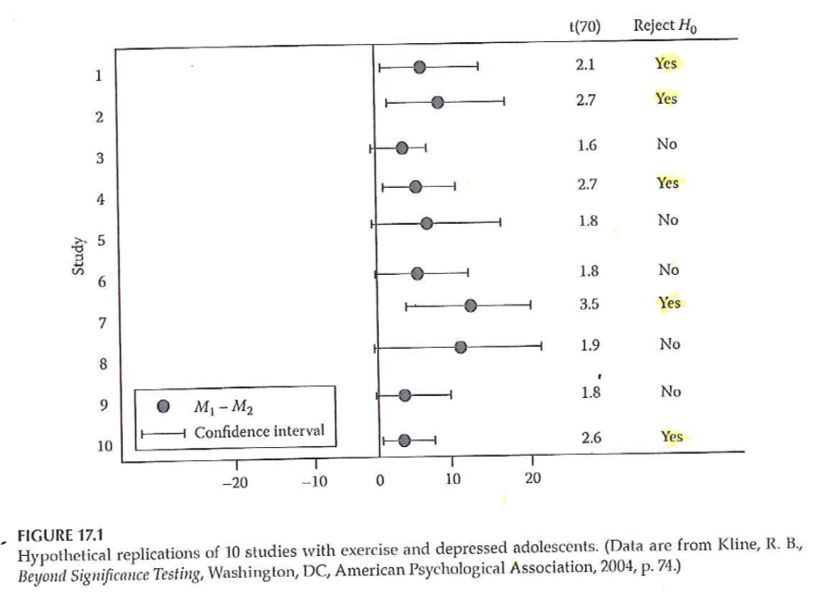
Making Inferences - EBA
Notes:
Interpreting 95% CI (Fig 17.1)

Slide 127
Making Inferences – EBA
Effect size –
Strength of relationship between IV & DV
Magnitude of the difference between levels of the IV with respect to the DV
3 types of effect size measures
r family
d family
Measures of risk potency

Slide 128
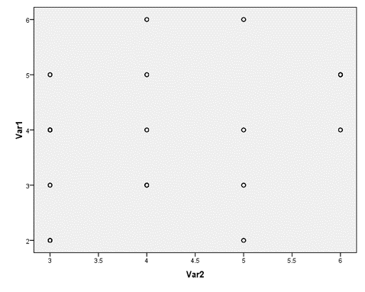
Making Inferences – EBA
Notes:
Why is effect size at least as important as significance level?
Influence of sample size on results

Slide 129
Making Inferences – EBA
Effect sizes –
Unstandardized – in the units of the raw DV
Standardized –
Standardized using pooled standard deviation of the groups
Measure that can be used to compare to other studies with different DVs

Slide 130
Making Inferences – EBA
Types of effect sizes –
R family – strength of association
D family – magnitude of differences
Measures of risk potency – when both IV and DV are dichotomous
Odds ratio
Relative risk
Risk difference

Slide 131
Making Inferences – EBA
R family of effect sizes – association
r 2 vs r
Cohen’s guidelines
Weak approx +/- .1
Medium approx +/- .3
Strong approx +/- .5
Authors labeling
Less than typical
Typical
Greater than typical
Also rho, phi, eta, R

Slide 132
Making Inferences – EBA
D family of effect sizes – differences
d <U+F0E8> Two group comparison
Treatment group mean – Comparison group mean
Divided by pooled standard deviations from both samples
eta 2 <U+F0E8> Multiple group comparison
Statistics packages will compute
Interpret like r 2 (amount of variance in DV accounted for by IV)

Slide 133
Making Inferences – EBA
Risk family of effect sizes – When both IV and DV are dichotomous
Phi – measure of association / correlation
Clinical / medical research – the risk of clinical outcomes
Relative risk – ratio that compares the risk of an outcome between groups
Risk difference – percentage difference that compares risk of an outcome between groups
Odds ratio – Odds of outcome in control group compared to odds in treatment group

Slide 134
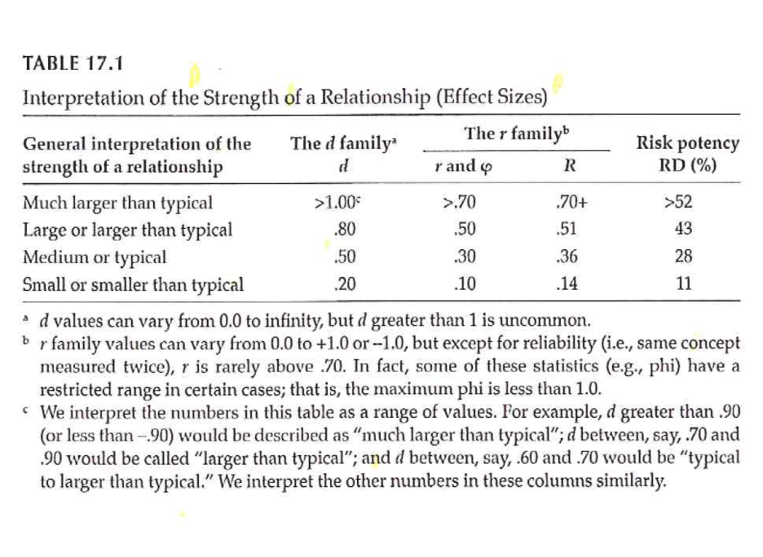
Making Inferences – EBA
Notes:
Interpretation of effect sizes –

Slide 135
Making Inferences – EBA
Value of effect sizes –
Indicates the strength of a relationship or a difference
Allows you
Combine results from studies with dissimilar outcome measures
Use findings of previous study to plan study with different outcome measure
Online source to perform power analysis –
Sample Power (part of SPSS)
Russell Lenth – U of Iowa

Slide 136
Making Inferences – EBA
Meta-Analysis
Research synthesis of multiple studies
Uses effect size value from each study
Advantage over systematic review – compute a summary statistic that represents overall estimate
Provides evidence of reliability of research finding
Include findings from studies that failed to find statistical significance
Increased external validity

Slide 137
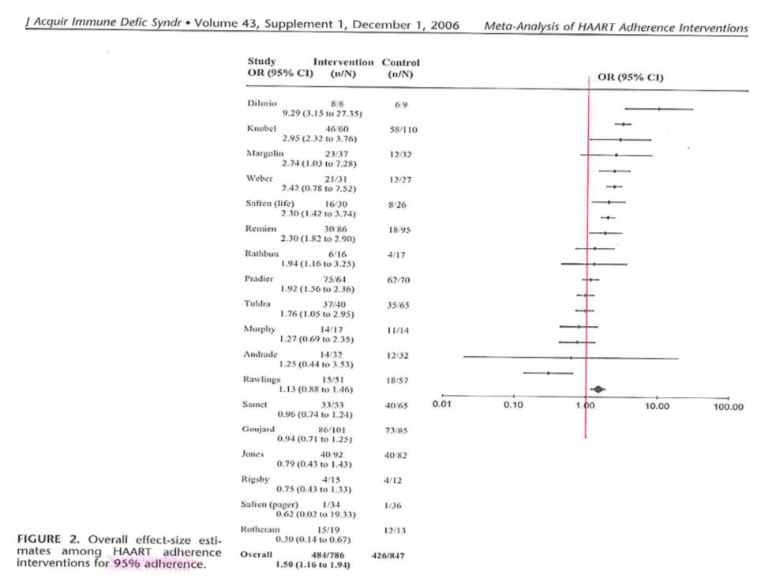
Making Inferences – EBA
Notes:
Simoni et al., 2006

Slide 138
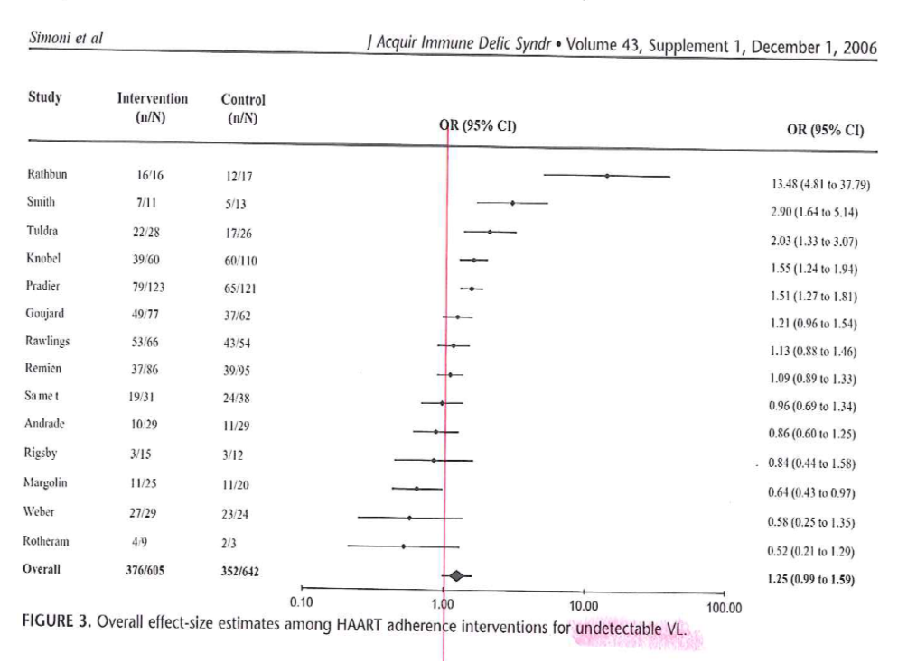
Making Inferences – EBA
Notes:
Simoni et al., 2006

Slide 139
Assignment #9
Complete an “outline” of your written proposal. Refer to the “Research Proposal Structure Overview/Structure” document in the Course Content folder on Blackboard. This “outline” should reflect a substantial amount of detail including sub-headings in the literature review section and methods section. Sections that reflect earlier assignments should contain near-complete drafts of the information that is relevant to your proposed project.
Available resource –
Research Proposal Structure Information document
Week by Week / General Information

Slide 140
Assignment
Prepare an “outline” for your written research proposal that is the final project. The outline should include the various sections that should be in the Methods section of the proposal. Given the work done on the previous assignments, this outline should include a substantial amount of detail.
Prepare for next weekâ€™s session

Slide 141
Discussion questions
What is meant by the “null hypothesis” versus a “research hypothesis”; which is being tested by the statistical analysis of the data; and can you “prove” a null hypothesis?
Will you include research questions or research hypotheses in your research proposal?
Do you have information available that is needed to determine sample size for your planned research project?
What outcome variables will be the focus of your research questions/hypotheses?

Slide 142
Additional slides

Slide 143
Sampling
Sample size
General rules
Representativeness vs number
Impact of having very large sample sizes
Generally –
Need sample to be large enough so you don’t miss important findings
If very large sample, need to distinguish statistical significance vs clinically important
Notes:
How many people do I need. This best done using a power analysis. Take account of the measures being used and what you expect to see. Information from previous research or other kinds of things.
Representativeness is more important than the absolute size of the sample.
Large enough so you don’t miss important findings.
In cases with really large sample sizes where you get statistical significance without practical significance. Effects.

Slide 144
Internal Validity
“The extent to which we can infer that the independent variable caused the dependent variable.”
For non-experimental studies –
How “well designed and conducted” was the study?
Three criteria for causality
Notes:
It’s really only randomized trials that can establish causality. But even in quasi-experimental and non-experimental studies, you can still talk about internal validity.
The cause has to precede the effect, it must be connected to the effect, and there must be no other variables that could explain why the cause is related to the effect.

Slide 145
Internal Validity
“The extent to which we can infer that the independent variable caused the dependent variable.”
Three criteria for causality
IV must precede the outcome variable
IV must be related to the outcome
There must be no other variables that could explain why the IV is related to the outcome

Slide 146
Internal Validity
Three criteria for causality –
IV must precede the outcome variable
IV must be related to the outcome
There must be no other variables that could explain why the IV is related to the outcome
By Research Approach –
Randomized Exp
Quasi- Exp
Comparative
Associational
Descriptive

Slide 147
Internal validity
Notes:
For randomized designs, the cause precedes the effect, the cause is related to the outcome and there are no other variables that could explain the relationship.

Slide 148
Internal Validity
Meeting the 3 causality criteria based on –
Strength of the research design
Internal validity
Notes:
The strength of the research design and the internal validity determine whether you can claim causality. Try to design the study to maximize internal validity.

Slide 149
Internal Validity
Internal validity -
Most often discussed with reference to randomized experimental and quasi-experimental designs
Can also be applied to non-experimental studies

Slide 150
Internal Validity
Evaluating the internal validity of a study –
Equivalence of the groups on participant characteristics
Control of extraneous experiences and environmental variables
Notes:
There are two aspects of internal validity, equivalence and control.

Slide 151
Internal Validity
Equivalence of the groups on participant characteristics –
Are groups equivalent prior to introduction of IV?
Randomized experimental design –
Random assignment
Quasi-experimental design –
Random assignment of treatments
Matching
Checking pretest scores
Notes:
Random assignment assures equivalence of the two groups on average. A rule of thumb is 30 people assigned to each group should give you confidence that random assignment will assure equivalence. If you are using random assignment, you should not need to test for baseline equivalence. We feel that random assignment is the best way to achieve equivalence.
In quasi-experimental design, you don’t have random assignment, but you can randomly assign between the two groups. You can also use matching to achieve equivalence. Finally, you can check baseline scores for equivalence.

Slide 152
Internal Validity
Equivalence of the groups on participant characteristics –
Are groups equivalent prior to introduction of IV?
Comparative design –
Statistical adjustment (ANCOVA) to adjust DV scores to make groups more nearly equivalent
Matching participants on variables other than the primary IV
E.g. Case-control study
Check after the study for comparability
Notes:
Since non-randomized trials have an attribute variable, you need to rely on statistical adjustment or matching. You can also check after the study for comparability.

Slide 153
Internal Validity
Equivalence of the groups on participant characteristics –
Are groups equivalent prior to introduction of IV?
Associational design –
Only 1 group
Not able to provide evidence of causation
“Equivalence” – “… whether those who score high on the IV … are similar to those … who score low in terms of other attributes that may be related to the DV.”
May be able to provide some statistical control
Notes:
Equivalence when you have a continuous independent variable means that those who score high on the variable are similar to those who score low.

Slide 154
Internal Validity
Control of extraneous experiences and environmental variables –
Extraneous variables – variables other than the IV and DV
Environmental variables – conditions/variables that occur during the study
Contamination
Issue – Is one group affected more than the other(s)?
Less of an issue with a more controlled research setting
Notes:
Your study could be contaminated by other variables. These variables might be out of your control but which can influence the outcome.
Contamination: people in the intervention group are friends with the control group and share information.
The key issue is whether one group is more affected by extraneous variables.
In a controlled setting, there are fewer extraneous variables, but this changes in a field setting.

Slide 155
Internal Validity
Rating the dimensions of internal validity
Figure 8.2
Evaluating Research Validity framework
“Good” study – moderate to high internal validity on both dimensions
Notes:
Internal validity is measured by whether the two dimensions are addressed.

Slide 156
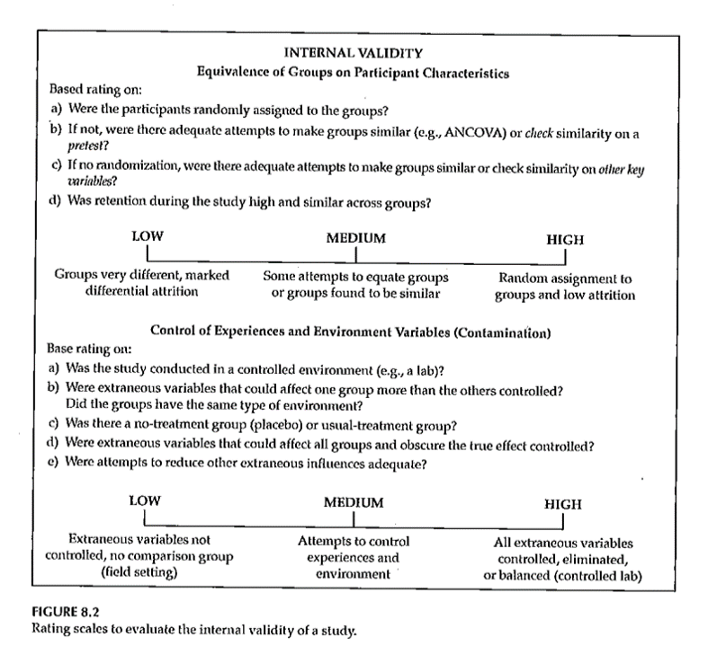
Internal Validity
Rating the dimensions of internal validity
Notes:
Figure 8.2.

Slide 157

Threats to Internal Validity
Notes:
Table 8.1 relates statistical terminology to identify threats to internal validity. This table tries to take those technical terms and express them
Extreme groups have issues with regression to the mean. Even without any intervention, the extremities will tend to lessen.
Dropouts or attrition means that you’ve designed a setting that is so difficult that no one can stay in. Differential attrition is especially troublesome.
Bias in assignment occurs when patients or their physicians directly or indirectly influence the assignment. Random assignment eliminates this bias.
Cook and Campbell.

Slide 158
Threats to Internal Validity
Equivalence of Groups
Use of extreme groups
Participant dropouts or attrition during the study
Bias in assignment to groups

Slide 159
Threats to Internal Validity
Control of extraneous/environmental variables
Changes due to time or growth and development
Extraneous environmental events
Repeated testing, carryover effects
Instrument or observer inconsistency
Combinations of two or more threats
Did the IV actually occur before the DV?
Notes:
Here are some of the sources of extraneous variables.
Maturation.
History. Something that occurs between the pre and post measurements that is independent of the intervention but which can influence the outcome.
Worry about sensitization to the issue in the baseline measurement that causes people to go out and find more.
Long studies have problems with instrumentation or observers (e.g., because of turnover).
There are also combinations of these events where one magnifies the other.
Temporal order of the variables. If you can’t assure that the independent variable occurs before the dependent variable, you can’t establish causation.

Slide 160
Threats to Internal Validity
Other threats
Effects of being in the control group
Expectation effect
Control for expectation
Observer / experimenter bias
Notes:
Control group contamination. Demoralization.
Hawthorne effect.
Blinding helps control for expectation effects and observer bias.

Slide 161

Validity
Notes:
Here is figure 8.1 again. The next part of this lecture talks about sampling and external validity.

Slide 162
Validity
Notes:
Here is figure 8.1 again. The extent to which results will generalize.

Slide 163
Assignment #7
Generate a list of variables that you plan to include in your research proposal. Include in the list both dependent and independent variables. In the list include:
Variables you will need to describe your sample,
Variables you will need to control for in your analysis, and
Variables you will need in order to test your RQ/RH.
Notes:
RQ=research question, RH=research hypothesis.

Slide 164
Measurement
What do we mean “ measurement ” ?
assignment of numbers or symbols to the different levels or values of variables according to rules. ”
Notes:
We are talking about measurement this week. You are either taking stats or have taken it in the past. This is not a statistics class. Think about what type of variables you will collect and propose what statistical analysis.
Your book defines it as the assignment of numbers or symbols. Notice that this takes a quantitative approach. But even in a qualitative study, you still going to want to summarize information like demographics of your sample. Describe the quality or quantity of a variable.
There are qualitative or quantitative ways to measure things like pain.
We can also use measurements to make absolute decisions. Establish a cut-point.
Conditions, distinctions.

Slide 165
Measurement
Assigning a number to represent …
Continuous value
Discrete value
Precision of measurement
Continuous variable …
Discrete variable …
Notes:
Value that is assigned can take on any value. Preciseness is dependent on the device used to collect the measurement. It could be the precision of a laser versus a cruder measure. Precision should be appropriate to what you are trying to get at. Lack precision does not mean that your results are not continuous. If you round to the nearest inch, you still are measuring an underlying construct that can take on more precision. Example is blood pressure, interbeat interval, where rounding is done but it still represents a continuous variable.
Discrete values because of rounding, using counts, or a limited number of categories. As long as it represents an underlying construct, consider it as continuous.

Slide 166
Measurement
What is the measurement representing?
Actual measurement …
Length, time, …
Indirect measurement
Constructs
Whatever you are trying to measure ..
Must be able to define it!
Notes:
A survey or scale to get at depression, pain, those kind of things. These are abstract variables.
Bottom line is to define and operationalize how you measure something. It’s easy to say something like quality of life but you have to pin this down and establish measurement validity. Consistency is important to avoid measurement bias.
Even for pretty obvious values like blood pressure, there are different ways to measure and you need to choose a single method for consistency and careful control, and when there are multiple methods, chose the method that is optimal for your needs. Blood pressure, for example, can be influenced by whether you are sitting or standing and whether you are talking while the measurement is being done.
Formalizing the rules for measurement helps reduce bias. This is a real concern when you have a variety of people doing the same measurements. How are new hires trained? Can you verify that they are trained to the standard that you have promised.

Slide 167
Measurement
Traditional levels (scales) of measurement
Nominal
Ordinal
Interval
Ratio
Notes:
Nominal means names, classification, or categorical assignment. Names are mutually exclusive and exhaustive. Value that is shown is a number code or a text word.
Ordinal is similar to nominal plus some orderliness as to what those responses mean. Example five point scale.
There is no true zero point. Can’t perform arithmetic operatitons on ordinal variables.
You can talk about the direction of change.
Interval - difference between levels is consistent across the range of the scale.
Ratio. There is a true zero point.

Slide 168
Measurement
Authors categorization of levels of measurement
Nominal
Dichotomous
Ordinal
Normally distributed
Table 10.1
Notes:
Gliner et al have a slightly different take. They talk about a normally distributed scale. It is hard to talk about the difference between ordinal and interval.
Look at the literature in the area you work with. Several Likert scales summed to get a subscale.

Slide 169

Measurement
Notes:
Table 10.1. This scale splits nominal into those with two levels (dichotomous, also known as binary) and more than two levels (nominal).
Remember how you coded nominal variables. You can (and should) use zero-one coding for dichotomous variables.
The average of a zero-one coded variable represents a probability.
Approximately normal scale requires at least five levels accorind to Gliner et al.

Slide 170

Measurement
Notes:
Table 10.3 gives examples of the Gliner et al scales.

Slide 171
Measurement
Why does the scale of measurement matter?
How it reflects your design and your research question
How it determines the types of statistical analyses you will do
How it defines what you can say about your results
Notes:
The level of measurement comes from what you are trying to get at in your research.
Measurement scales can limit what you can say about your results.

Slide 172
Assignment #6
Prepare a brief paragraph that describes the research design you are using for your research proposal. This is the information that will probably appear in the Methods section of your proposal.
Notes:
Go back are refer to Figure 4.1. Week 8 activities relate to the exemplar articles. These are on the Canvas site. There are six included. Pick one and get familiar with it.

Slide 173
Assignment
Prepare a brief paragraph that describes the research design you are using for your research proposal. This assignment will be used to describe the study design in the Methods section of your research proposal.
Prepare for next weekâ€™s session

Slide 174
Discussion questions
No discussion questions this week.

Slide 175
Additional slides

Slide 176
External Validity
Generalizability
Fig. 9.3
Evaluating Research Validity Framework
Two main aspects
Population external validity
Ecological external validity
Notes:
The extent to which results can be generalized beyond this study. Extrapolate to the bigger world.
Evaluating freamework (questions 14 and 15).
Population: how participants were selected.
Ecologic validity: the more control you have, the better the internal validity but the less like it is for real world. The naturalness of the setting, rapport.
Figure 9.3.

Slide 177
External Validity
Population external validity
How participants were selected for the study?
Is sample representative of the target population?
Validity framework

Slide 178
External Validity
Ecological external validity
Whether the results can be generalized to real-life outcomes
Trade-off with control of study
Validity framework

Slide 179

External Validity

Slide 180

Sampling and Validity
Notes:
Figure 9.4. External validity is influenced by the sampling process. Internal validity is influenced by the allocation of this sample to treatment groups.

Slide 181
Measurement Validity
Internal structure evidence –
“Evidence from several types of analysis, including factor analysis and differential item functioning …”
Does an analysis of the internal structure of a measure match the conceptual framework?
Notes:
Factor analysis is a method of grouping items representative of individual constructs.
In the week 9 folder is the MOTIV* document. The CES-D score has twenty items rated on a 0 to 4 scale, with four of the items reverse scaled.
There is a somatic factor in this scale. This might be considered a subscale. Run a factor analysis, even though it only has four levels. Do the items all hang together.

Slide 182
Measurement Validity
Factor analysis – Beliefs about ART measure
The following questions involve your personal views about the HIV medications that have been prescribed for you. Please indicate the extent to which you agree or disagree with the following statements.
Response scale: 1 (strongly disagree), 2 (disagree), 3 (uncertain), 4 (agree), 5 (strongly agree)
Notes:
The ones in yellow. Multiple items to represent a measure. Is there variability in any of those items. If you had selected one and only one item, it might be influenced by external factors like your mood. Multiple items avoid this problem.
The N items had Cronbach’s alpha of ?? and the C items had Cronbach’s alpha of ??.
A factor analysis allows us to see if the measure is behaving the way we expect it to.

